Slide 1

Project Title - Seasonal Agriculture Performance Analysis
Name: Khushi Wanjari
College Name: Indira Gandhi National Open University
AICTE STU ID: STU695e114374c101767772483

Slide 2

PROBLEM STATEMENT
Agricultural activities are influenced by seasonal variations in environmental conditions, farming practices, resource availability and market conditions. As a result, agricultural performance may differ from one season to another. However, raw agricultural data does not clearly explain how agricultural performance changes across seasons or what patterns can be observed in different seasonal conditions. The problem is to analyze the given agricultural dataset and investigate seasonal differences in agricultural performance by identifying meaningful patterns, trends, relationships and variations within the available data.

Slide 3
Project Description
The Seasonal Agriculture Performance Analysis project examines agricultural data to understand how farm performance changes across different seasons, crops, states, and irrigation methods. The dataset contains 4,000 farm records and 28 variables, including rainfall, temperature, soil conditions, fertilizer use, water use, crop yield, production, revenue, cost, and profit.
The project uses Python to clean and analyze the data through descriptive statistics, seasonal and crop-wise comparisons, resource-use analysis, environmental analysis, economic analysis, correlation analysis, statistical testing, and visualizations. The main aim is to identify the factors associated with higher yield, better water efficiency, and improved profitability. The findings can help farmers and agricultural planners make informed decisions about crop selection, irrigation practices, input use, and seasonal planning.

Slide 4

WHO ARE THE END USERS?
Farmers, for selecting suitable crops and improving resource use.
Agricultural planners and government departments, for seasonal and regional planning.
Agricultural extension officers, for advising farmers on irrigation, fertilizer, and pest-management practices.
Researchers and students, for studying agricultural performance patterns.
Agribusiness organizations, for understanding crop production, costs, and profitability.

Slide 5

Technology Used
Python: Main programming language used for data analysis.
Jupyter Notebook: Used to write, run, and document the analysis.
Pandas: Used for loading, cleaning, and analyzing the CSV dataset.
Matplotlib: Used to create charts and save them as images.
Seaborn: Used to create attractive statistical graphs and heatmaps.
SciPy: Used for the Kruskal-Wallis statistical test.
CSV file: Used as the source format for the seasonal agriculture dataset.
GitHub: Used to store and manage the Seasonal Agriculture Performance Analysis project online.

Slide 6
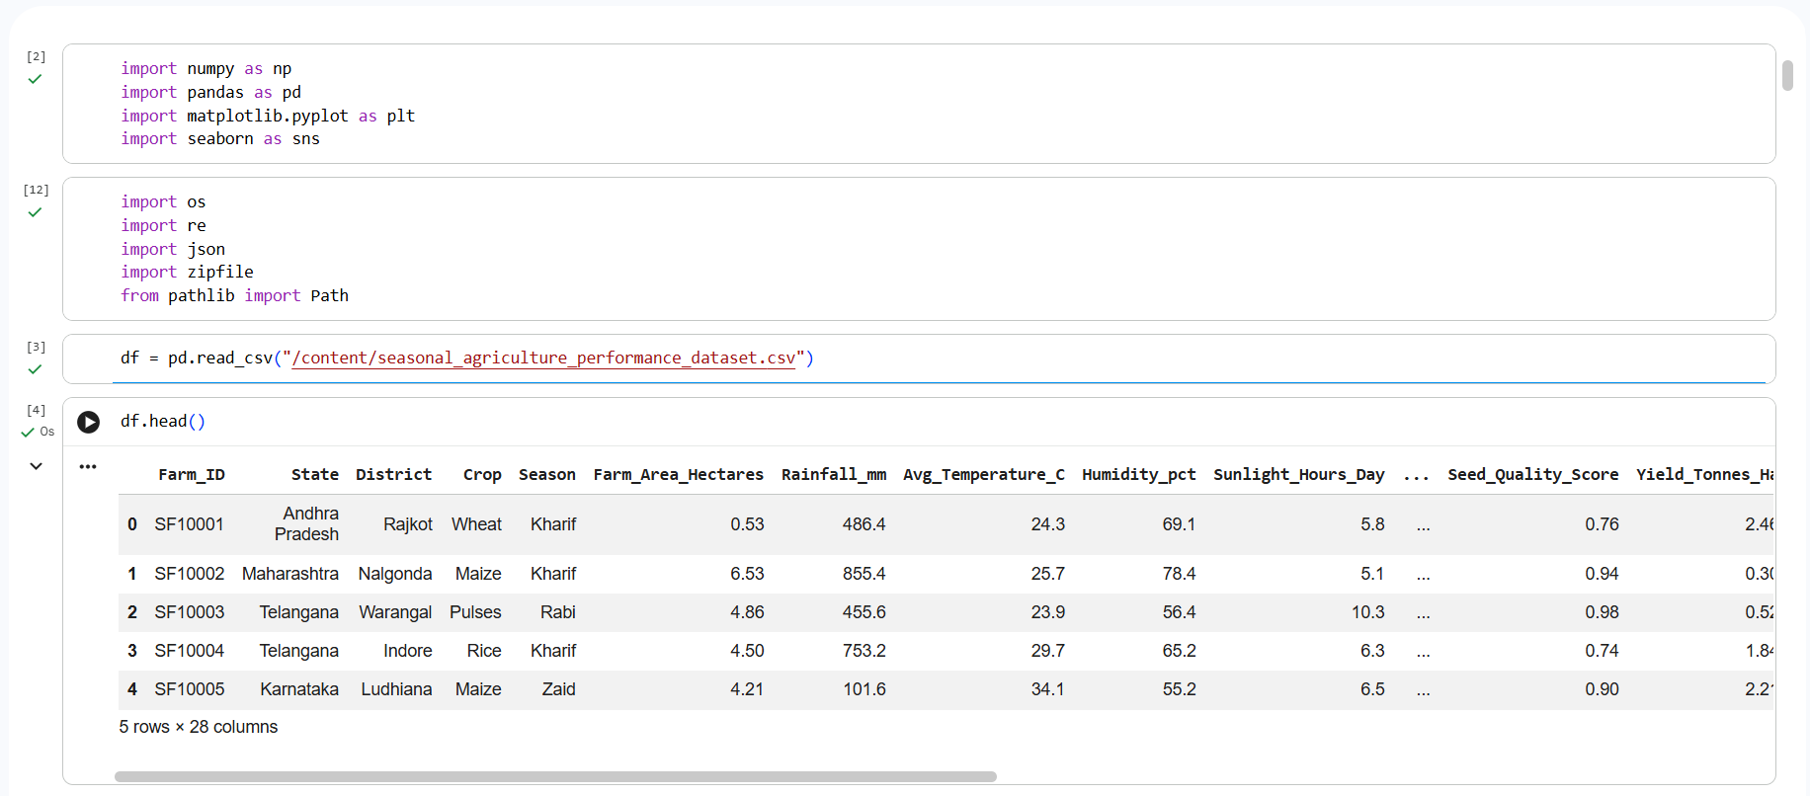
RESULTS

Slide 7
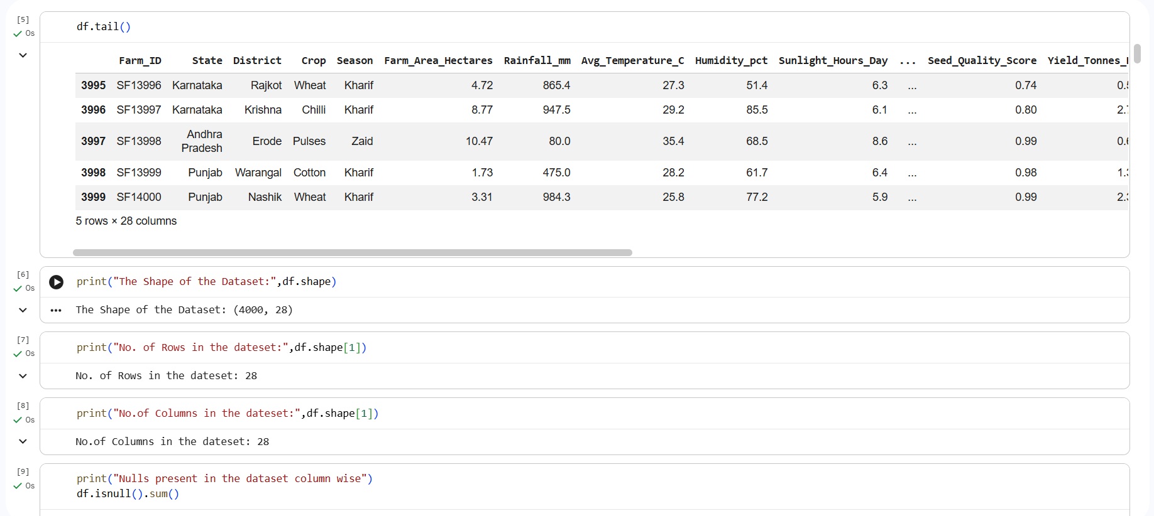
RESULTS

Slide 8
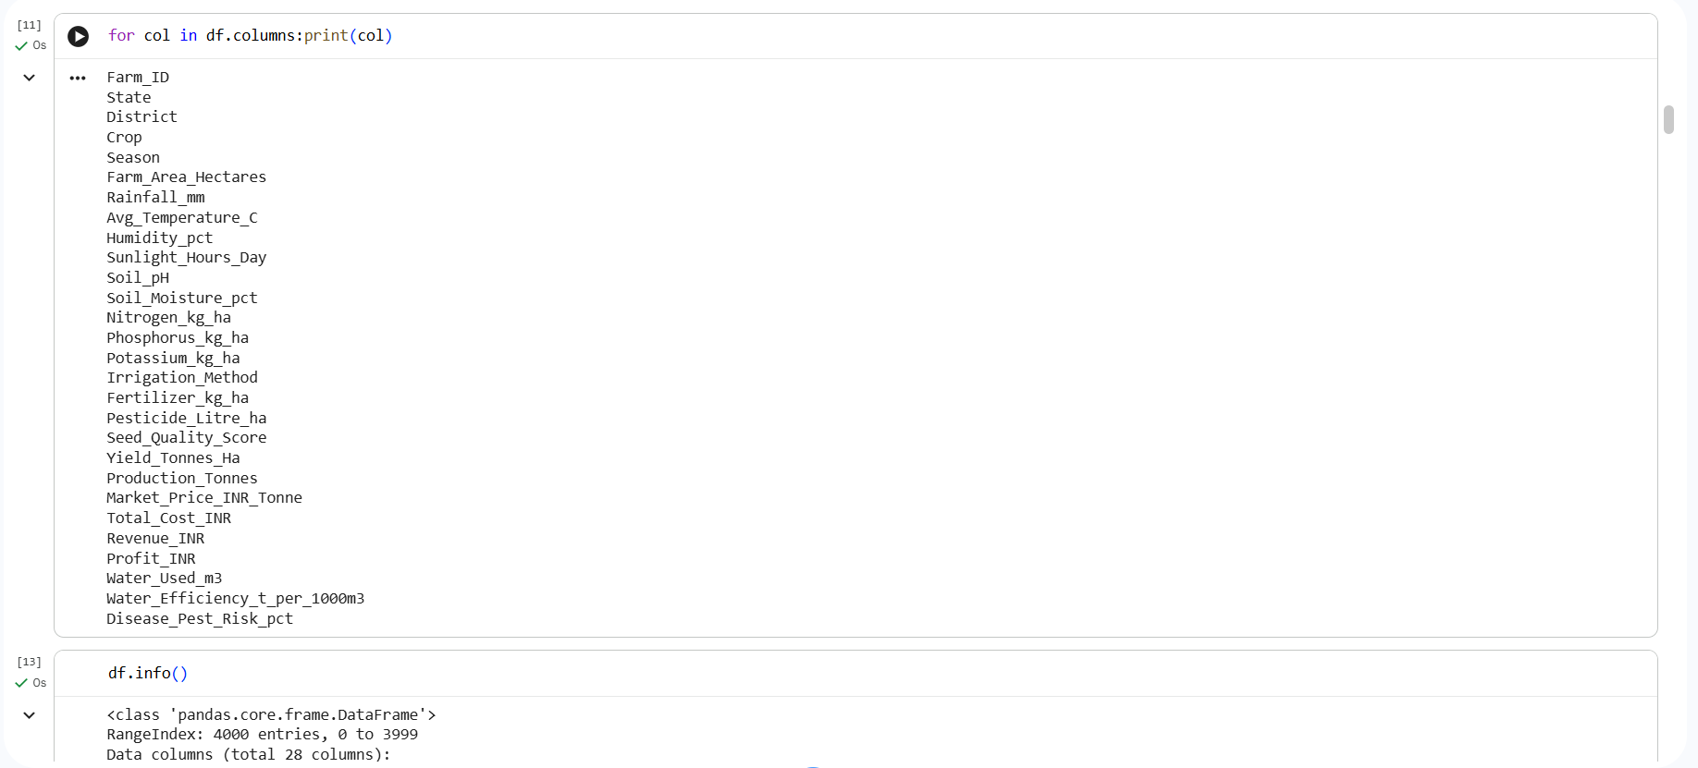
RESULTS

Slide 9
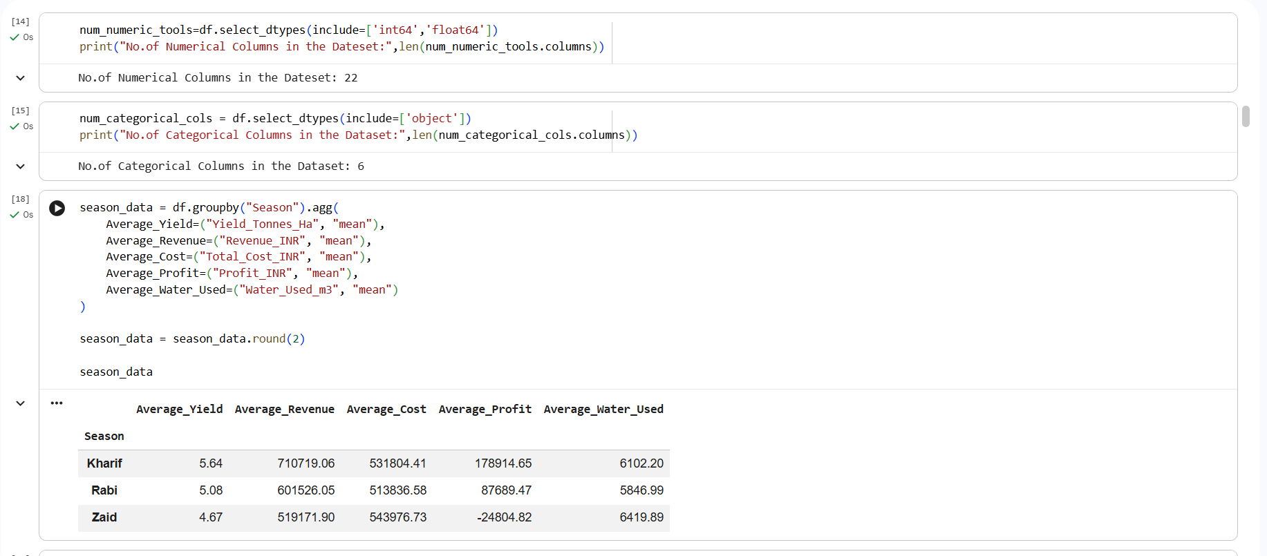
RESULTS
[Add screen shots of your code ]

Slide 10
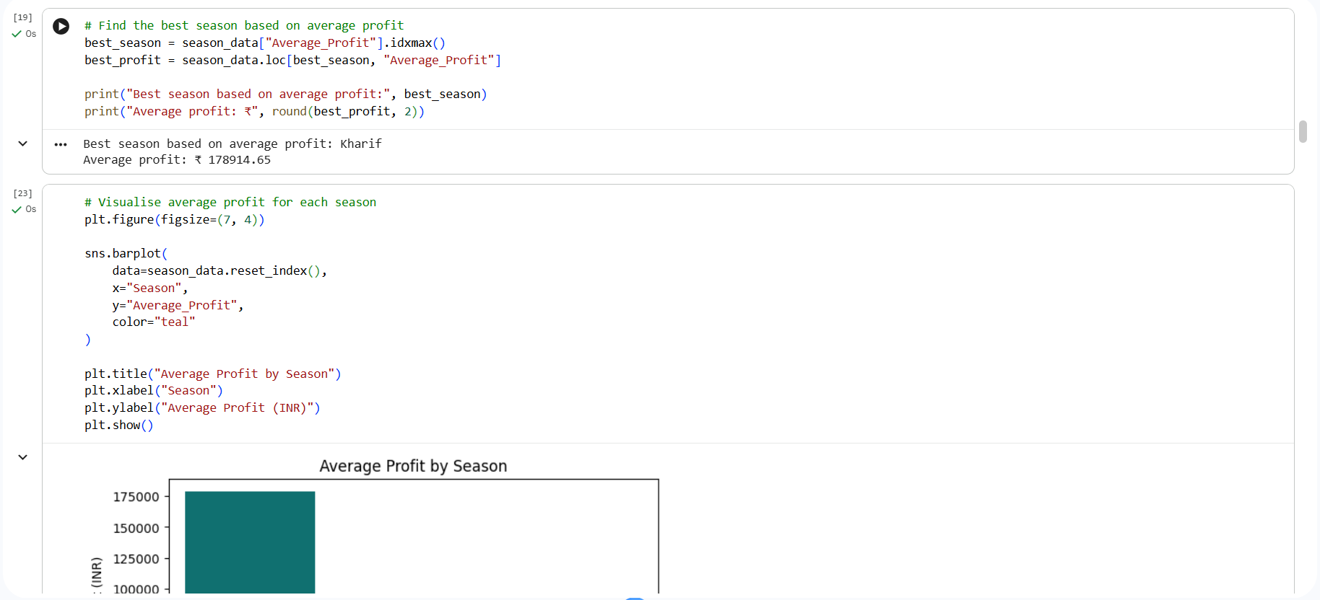
RESULTS
[Add screen shots of your code ]

Slide 11
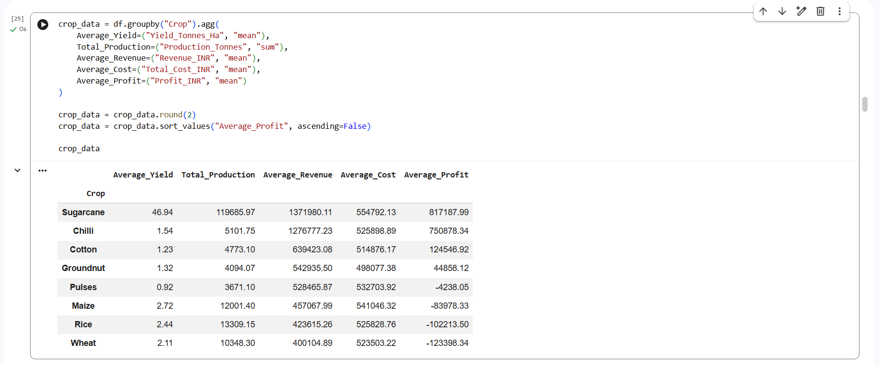
RESULTS
[Add screen shots of your code ]

Slide 12
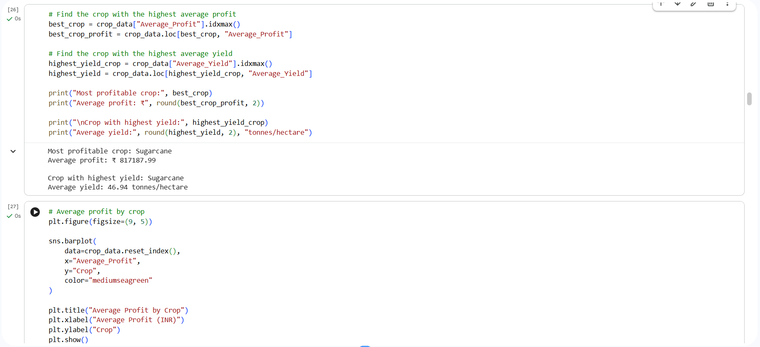
RESULTS
[Add screen shots of your code ]

Slide 13
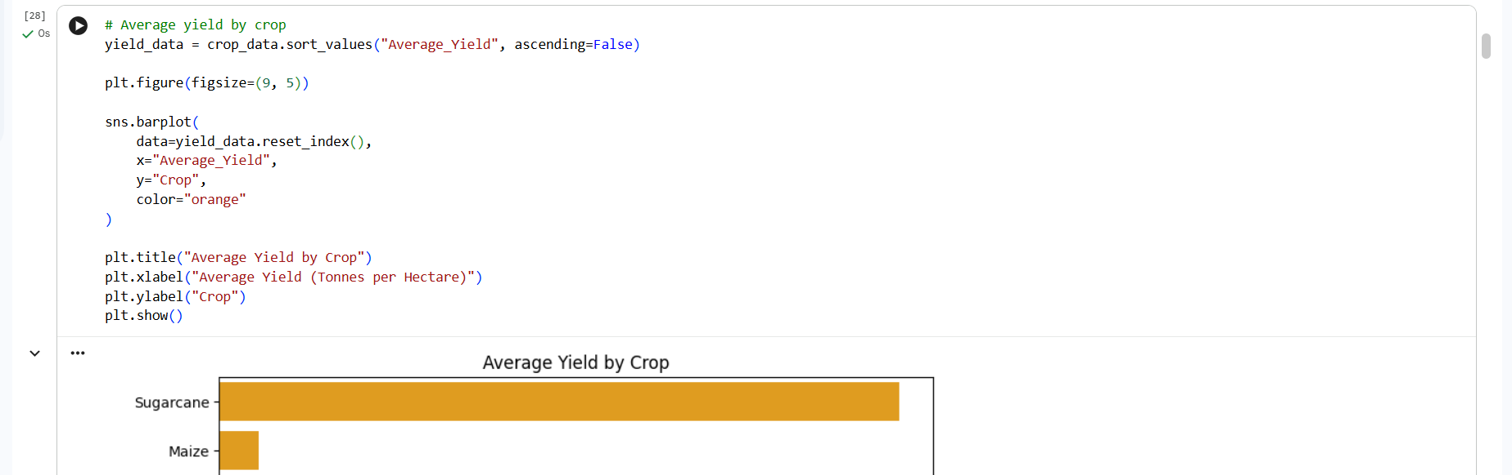
RESULTS
[Add screen shots of your code ]

Slide 14
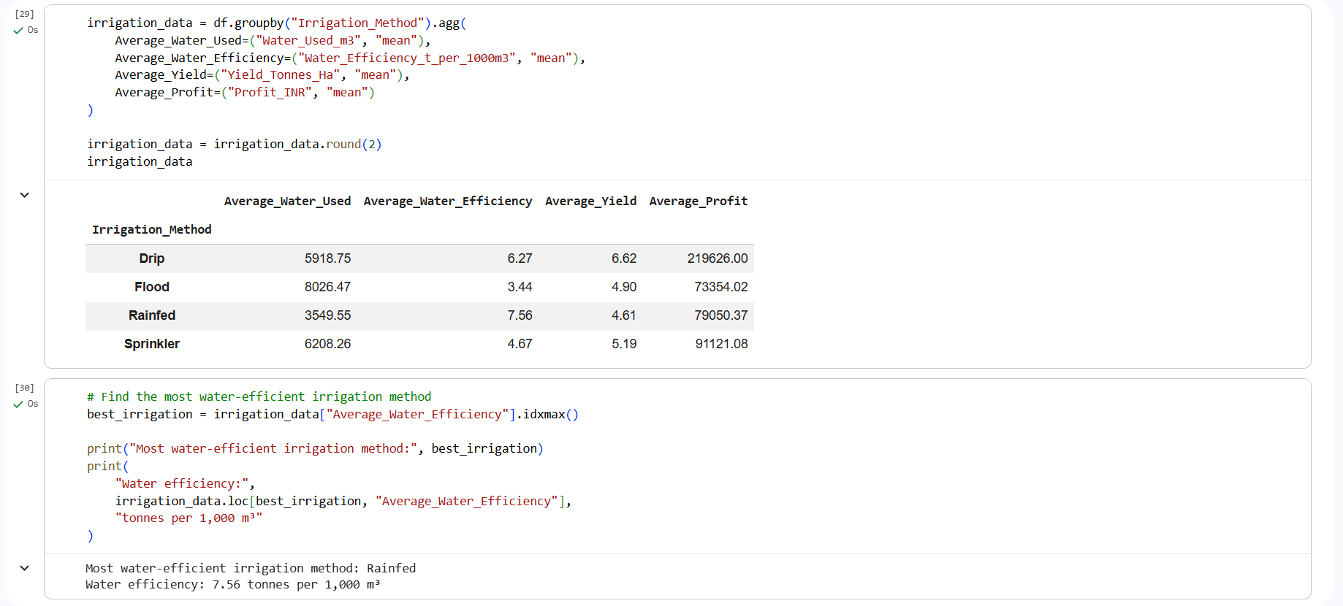
RESULTS
[Add screen shots of your code ]

Slide 15
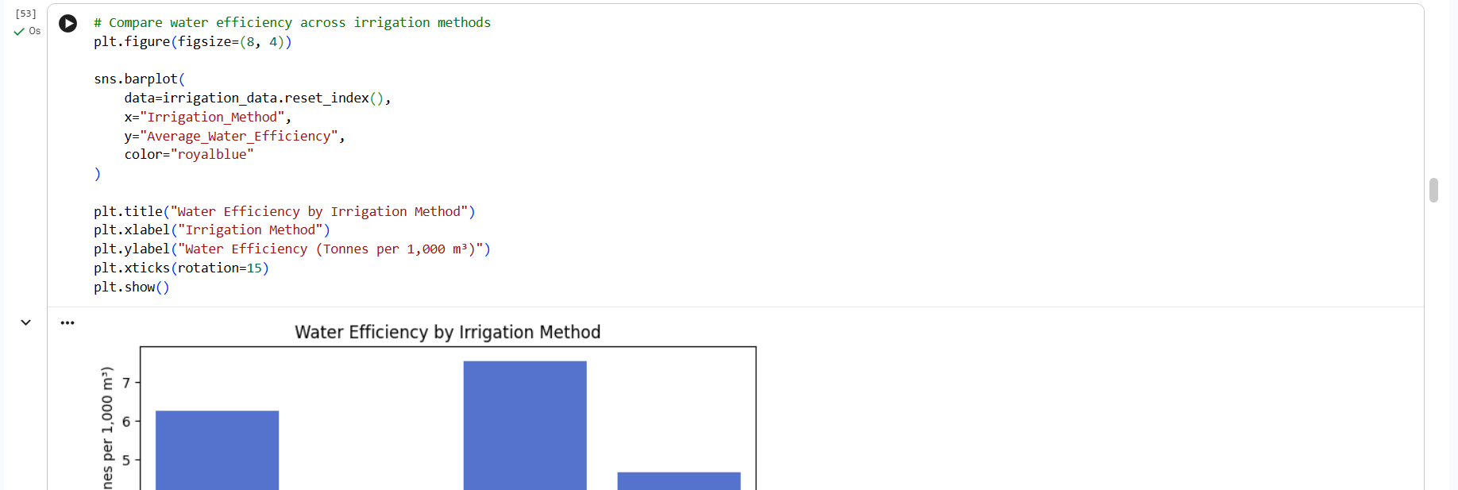
RESULTS
[Add screen shots of your code ]

Slide 16
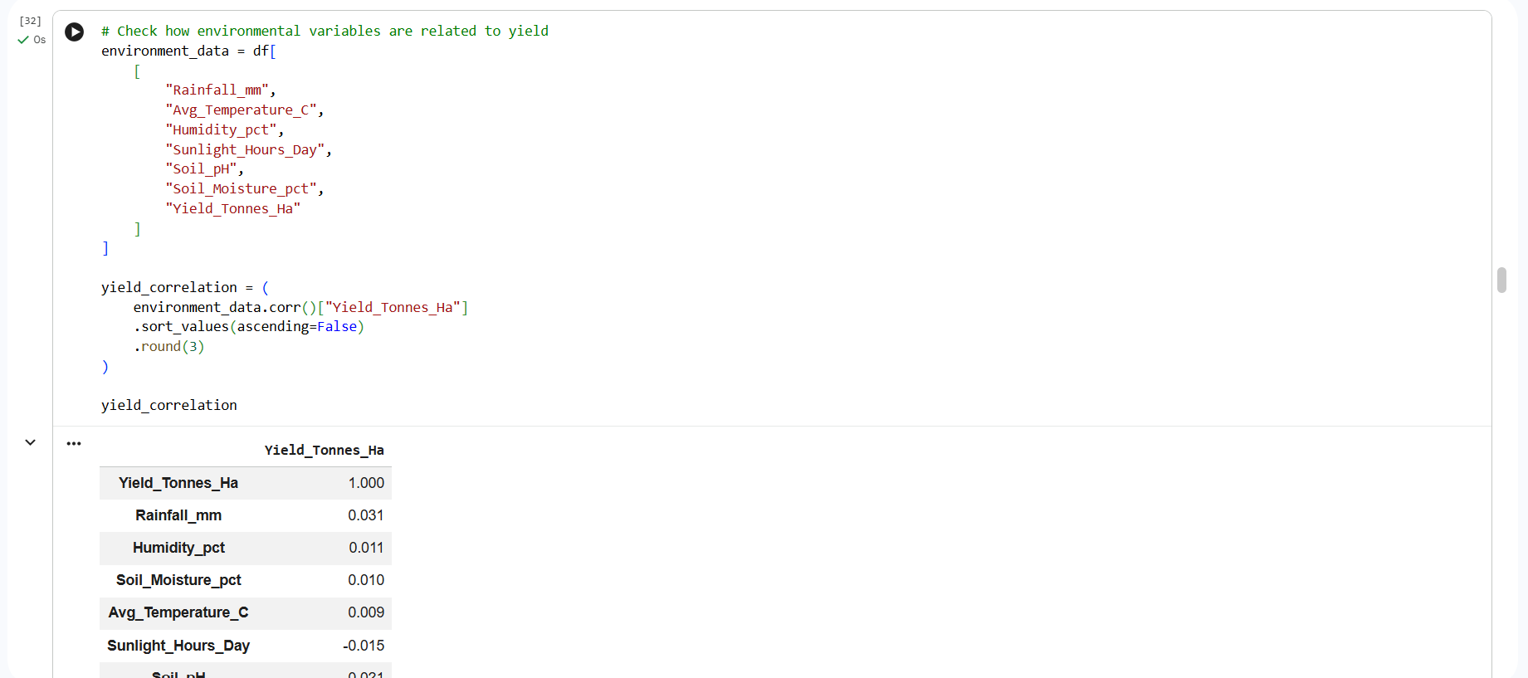
RESULTS
[Add screen shots of your code ]

Slide 17
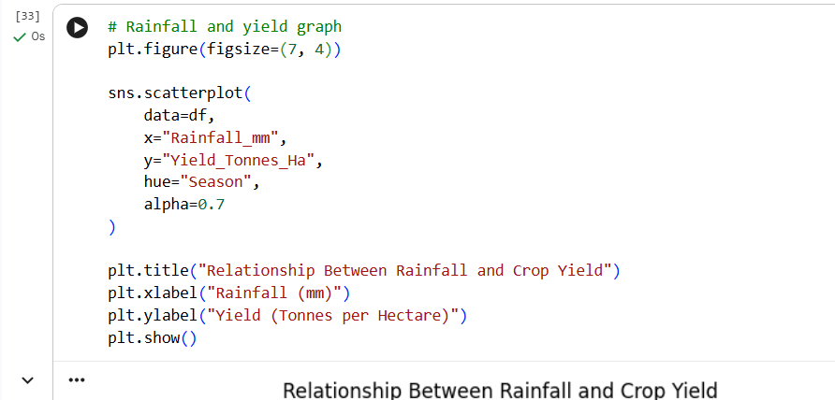
RESULTS
[Add screen shots of your code ]

Slide 18
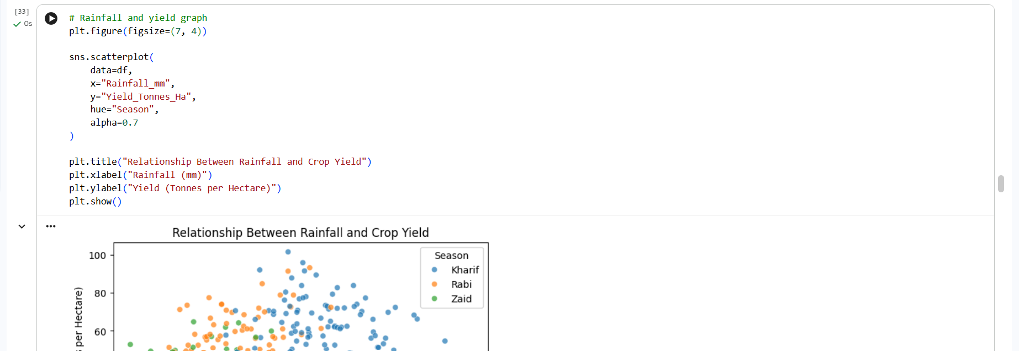
RESULTS
[Add screen shots of your code ]

Slide 19
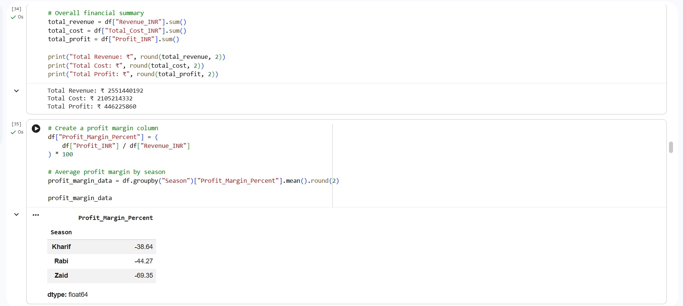
RESULTS
[Add screen shots of your code ]

Slide 20
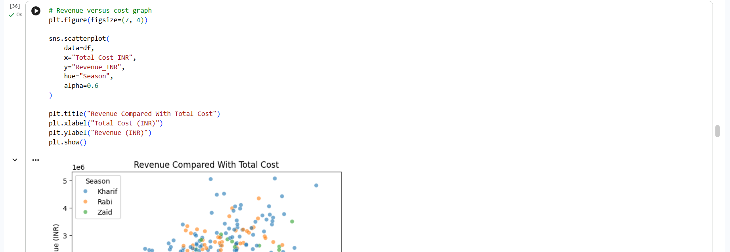
RESULTS
[Add screen shots of your code ]

Slide 21
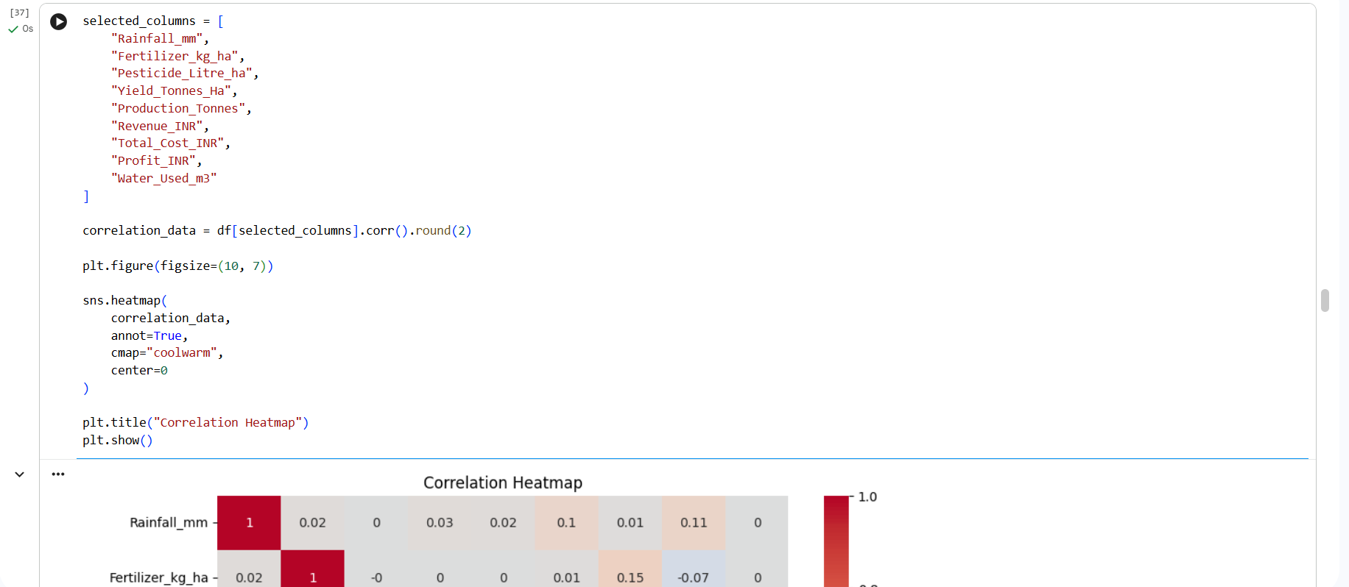
RESULTS
[Add screen shots of your code ]

Slide 22
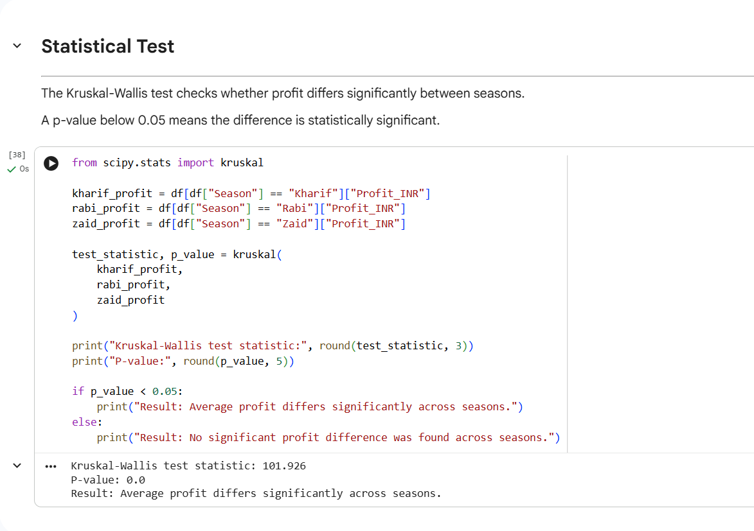
RESULTS
[Add screen shots of your code ]

Slide 23
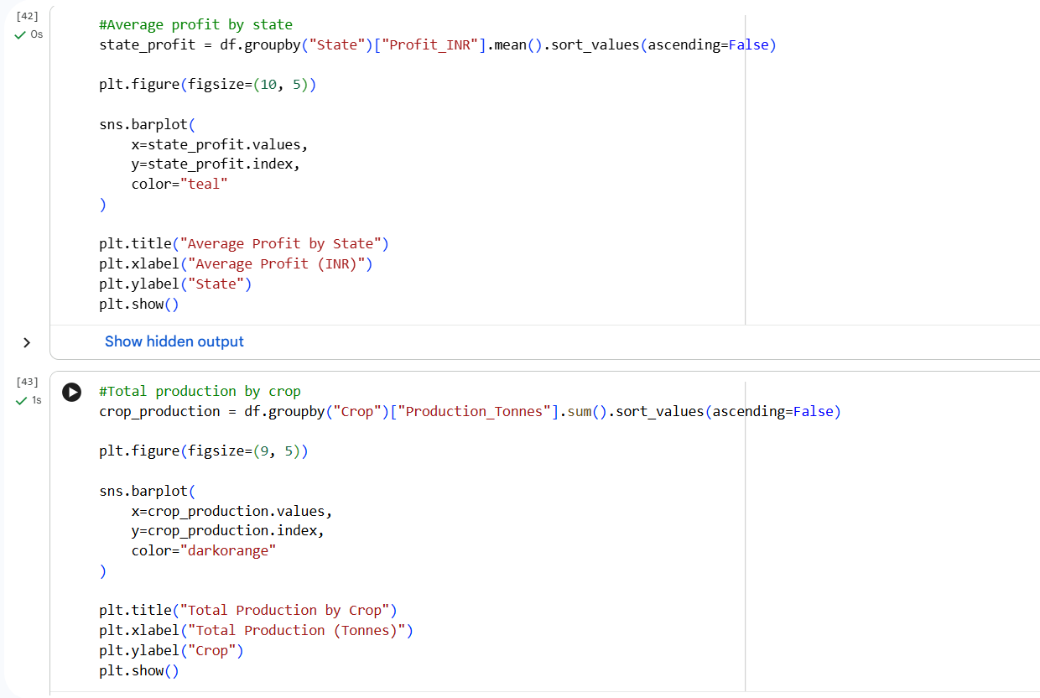
RESULTS

Slide 24
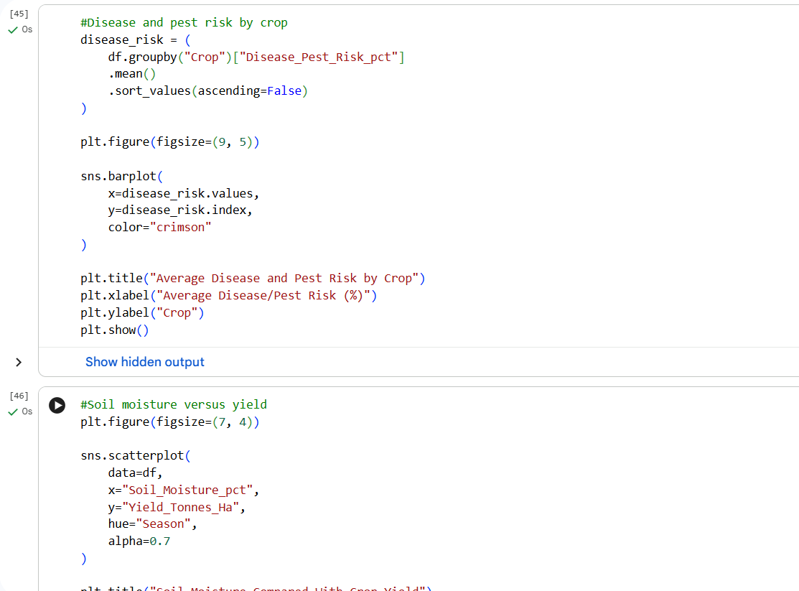
RESULTS

Slide 25
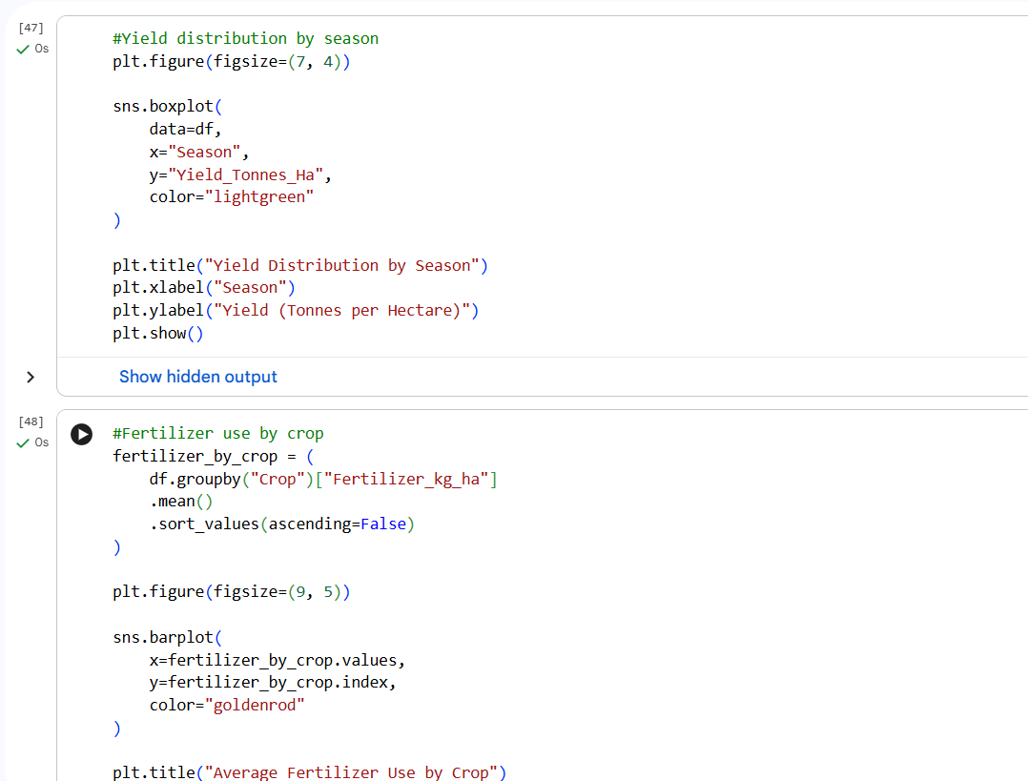
RESULTS

Slide 26
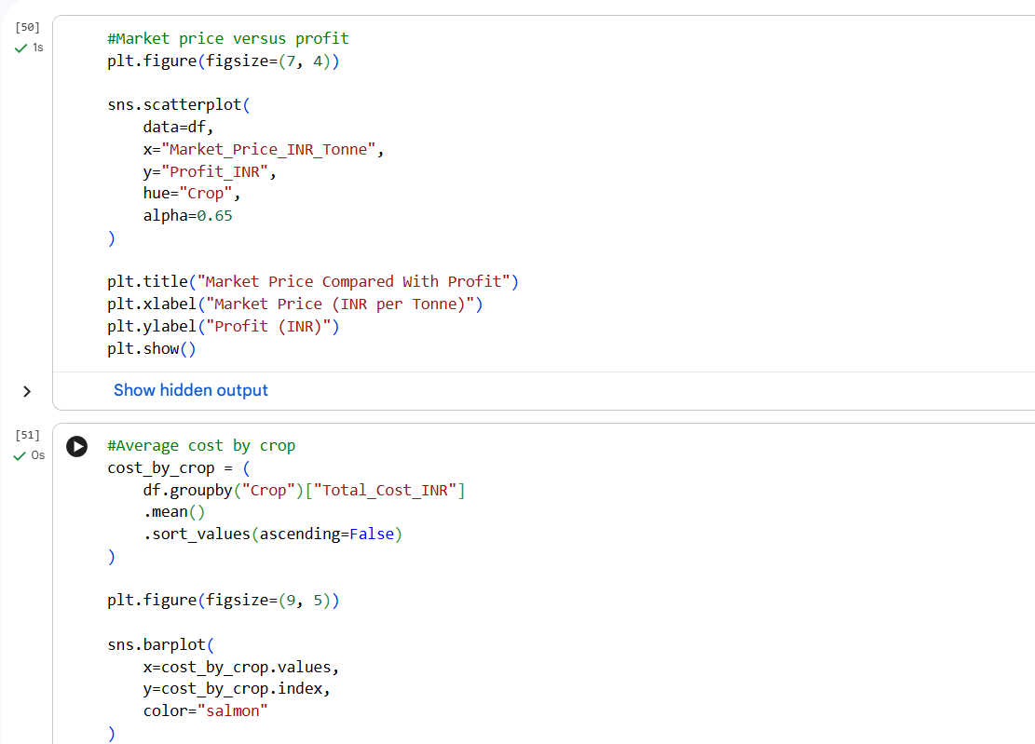
RESULTS

Slide 27
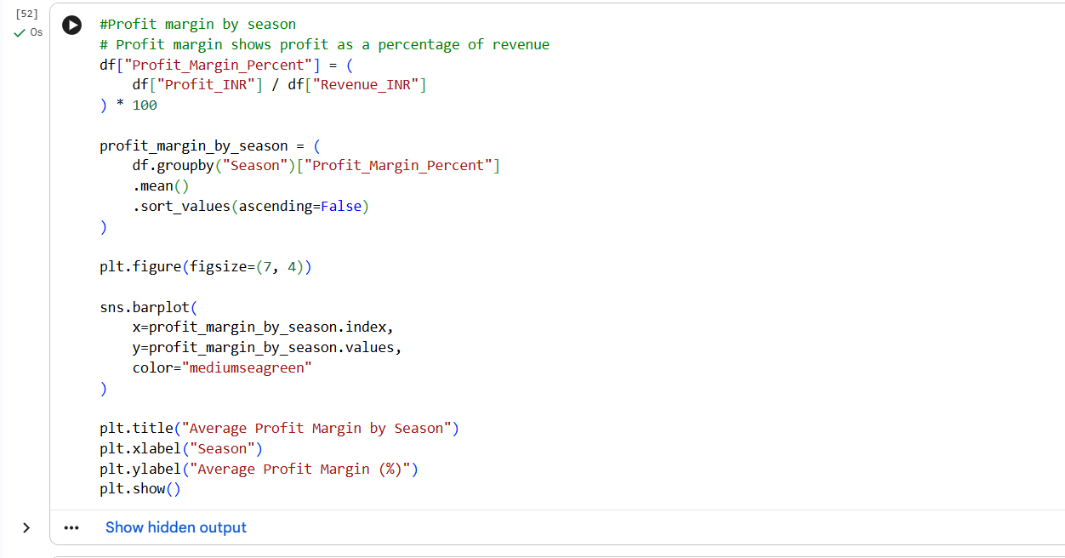
RESULTS

Slide 28
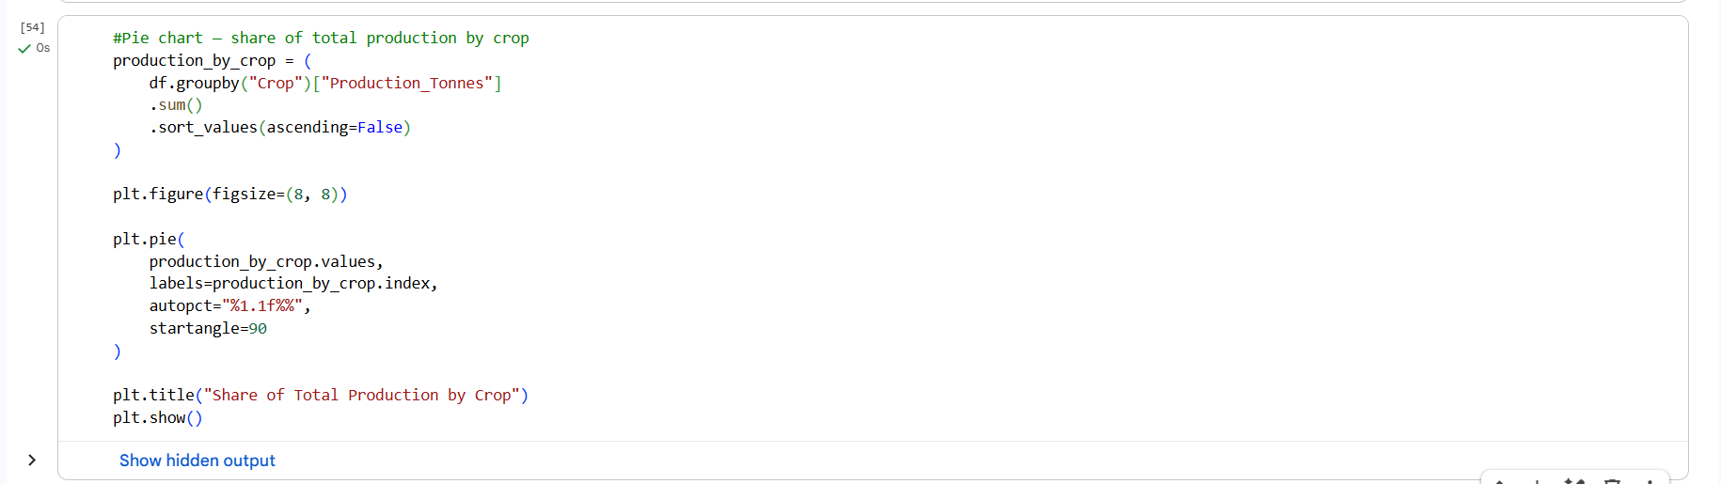
RESULTS

Slide 29
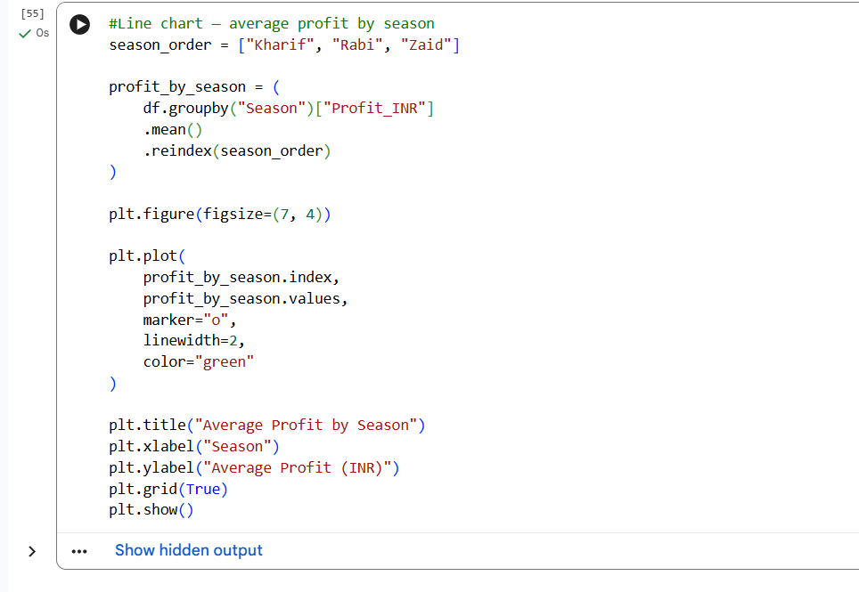
RESULTS

Slide 30
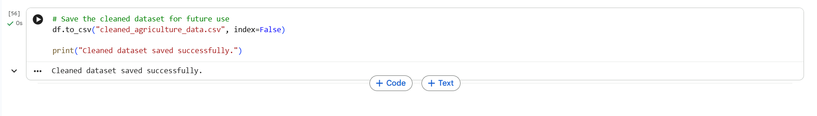
RESULTS

Slide 31
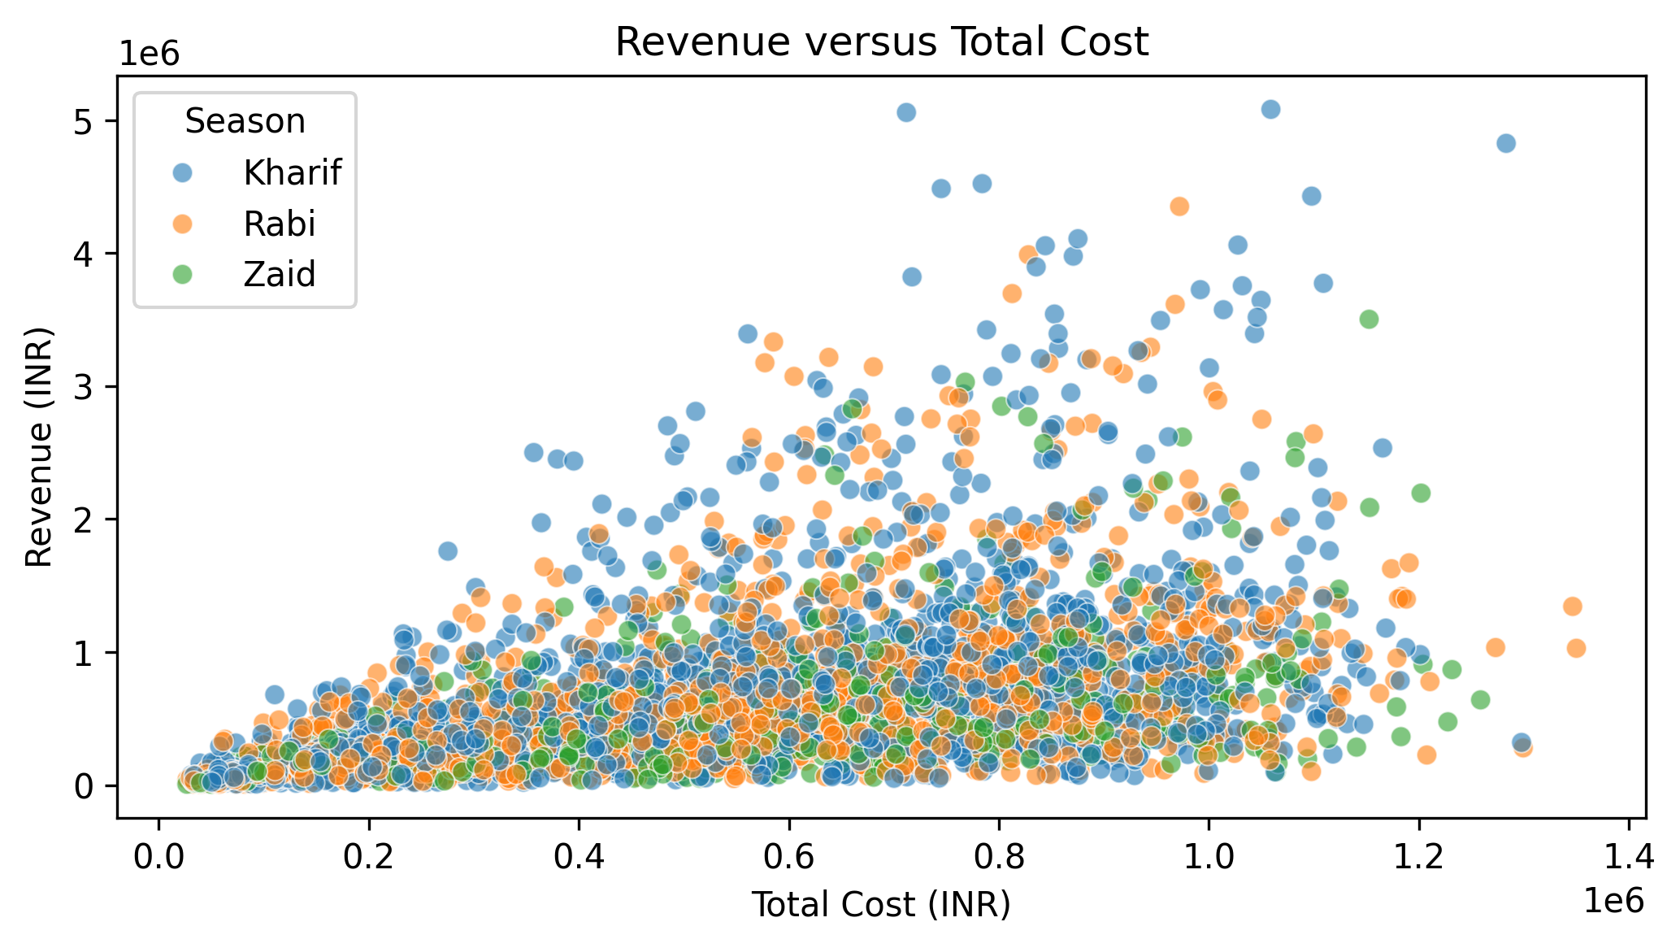
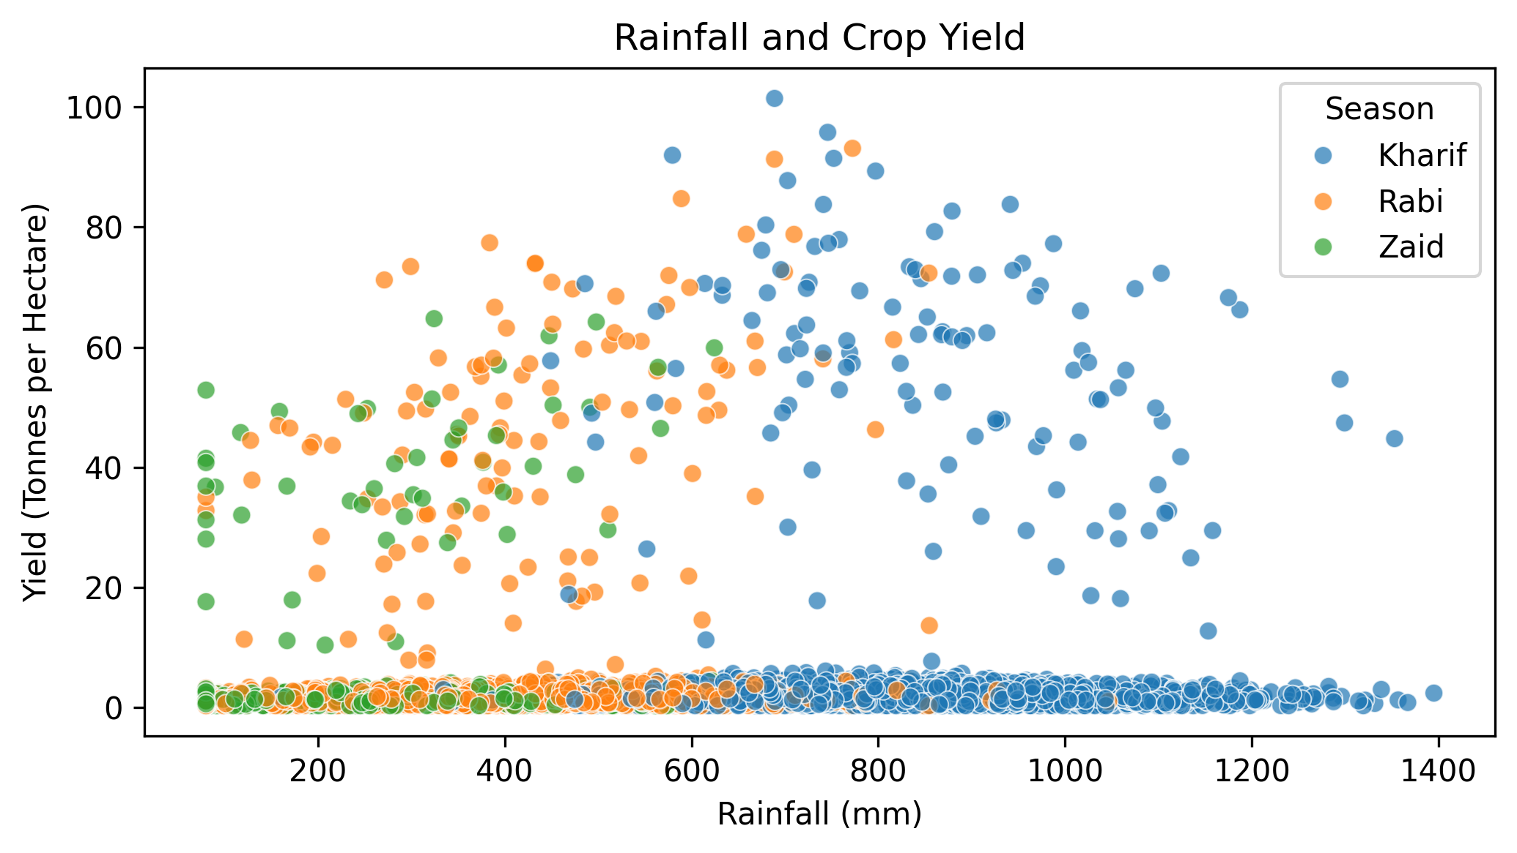
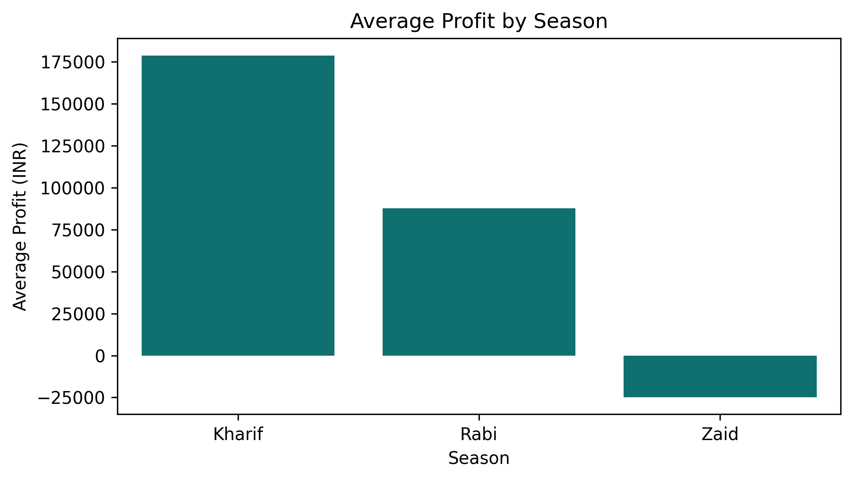
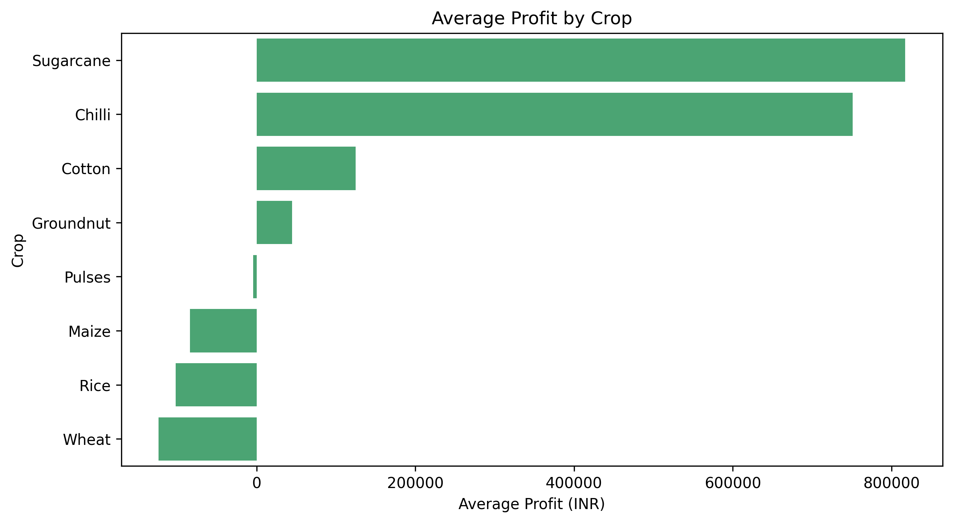
RESULTS

Slide 32
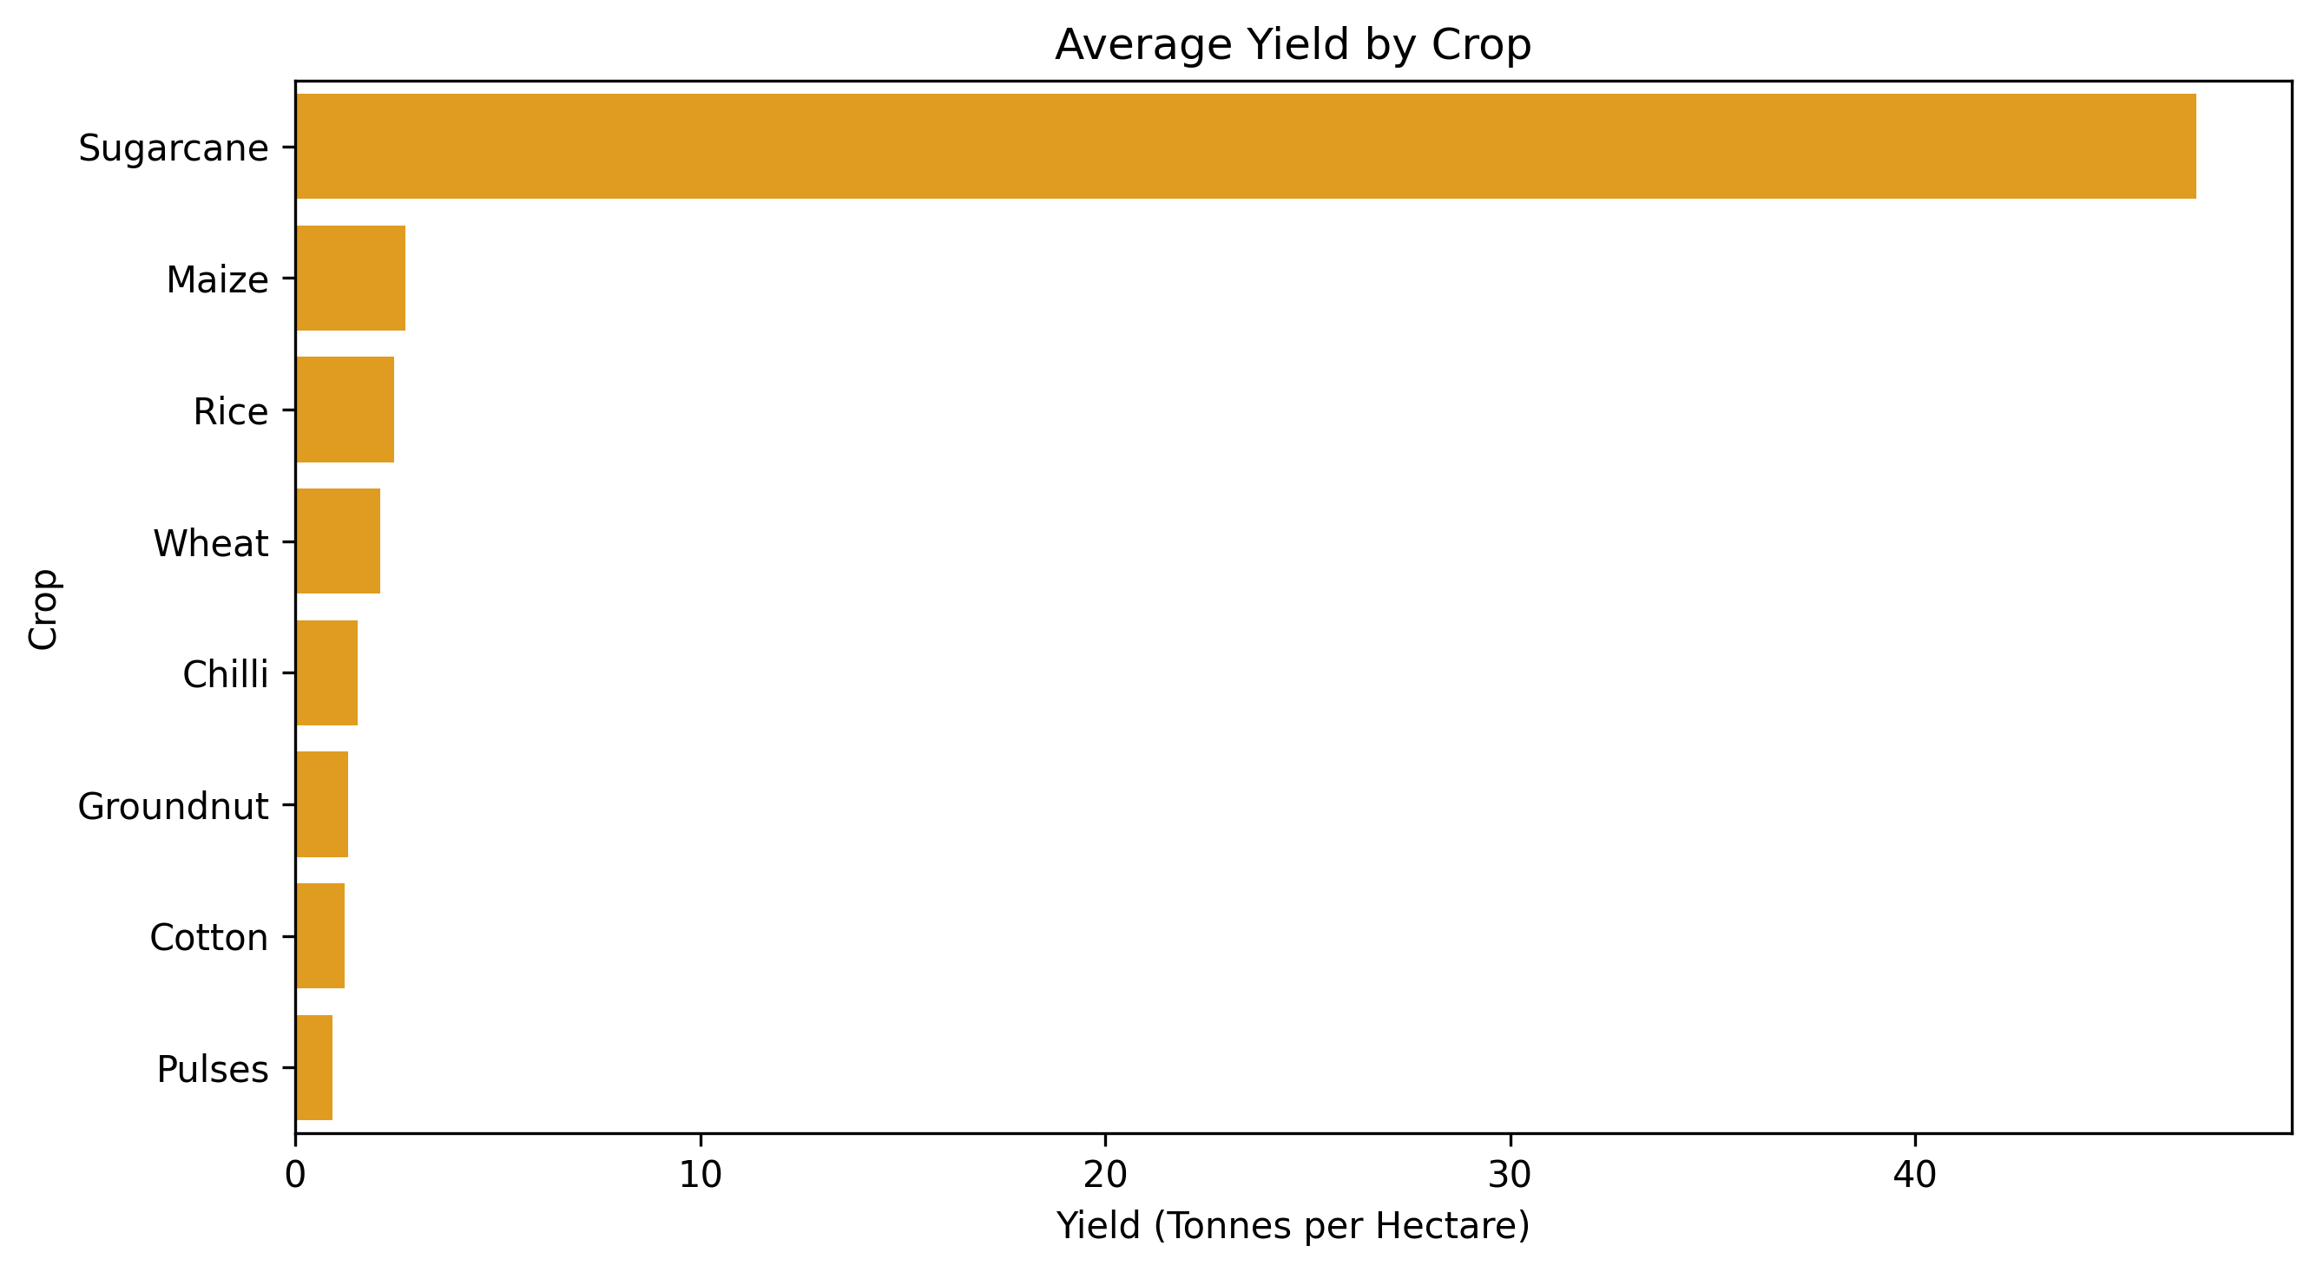
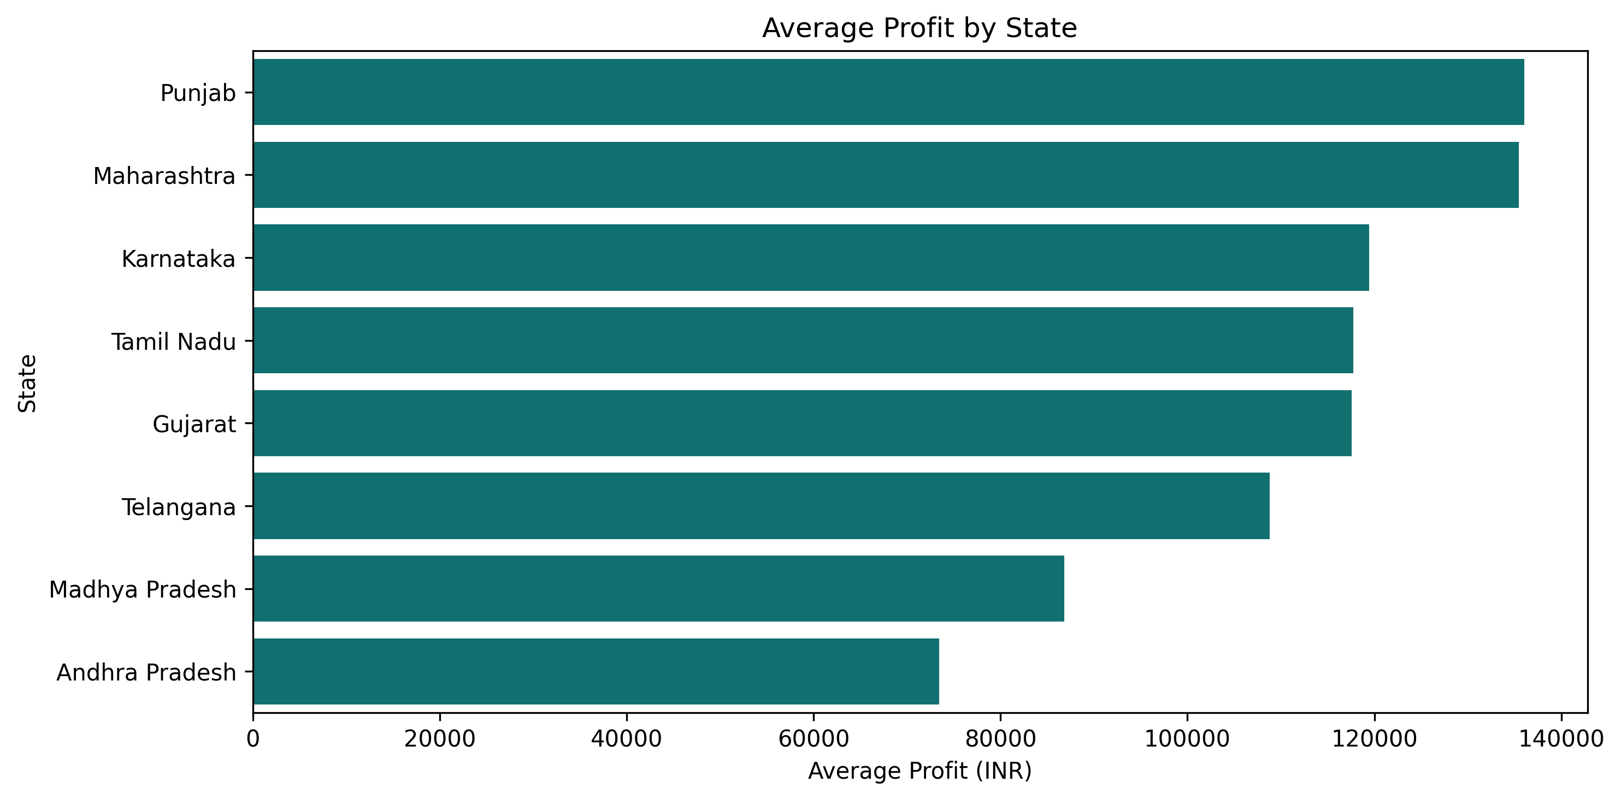
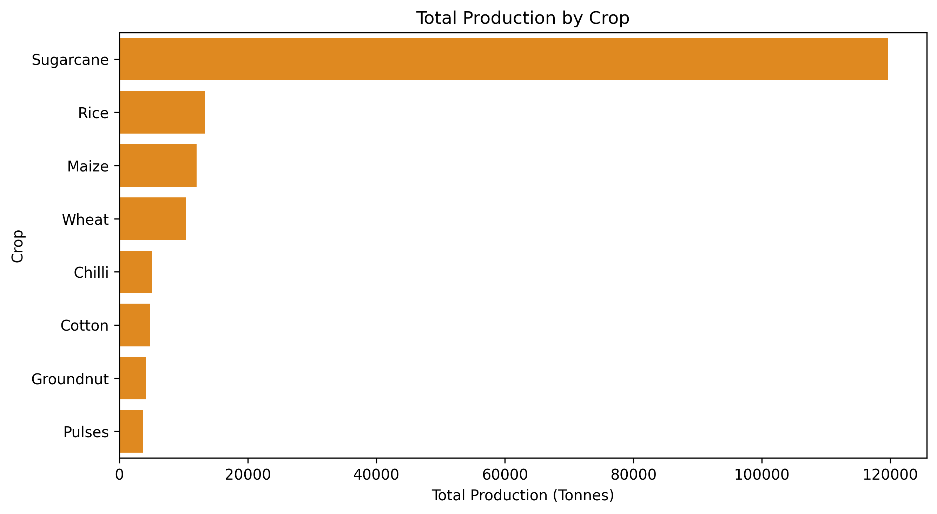
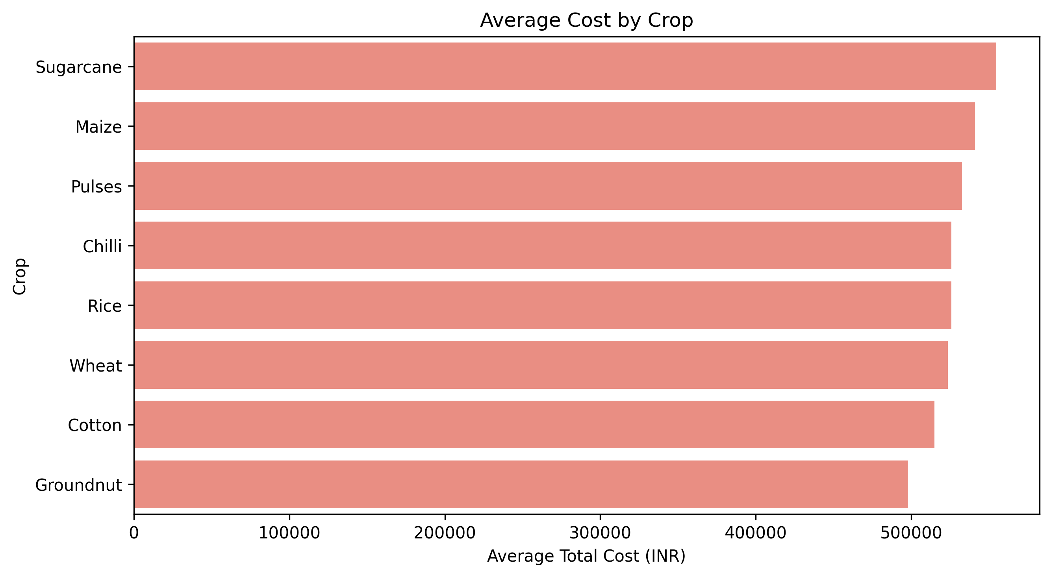
RESULTS

Slide 33
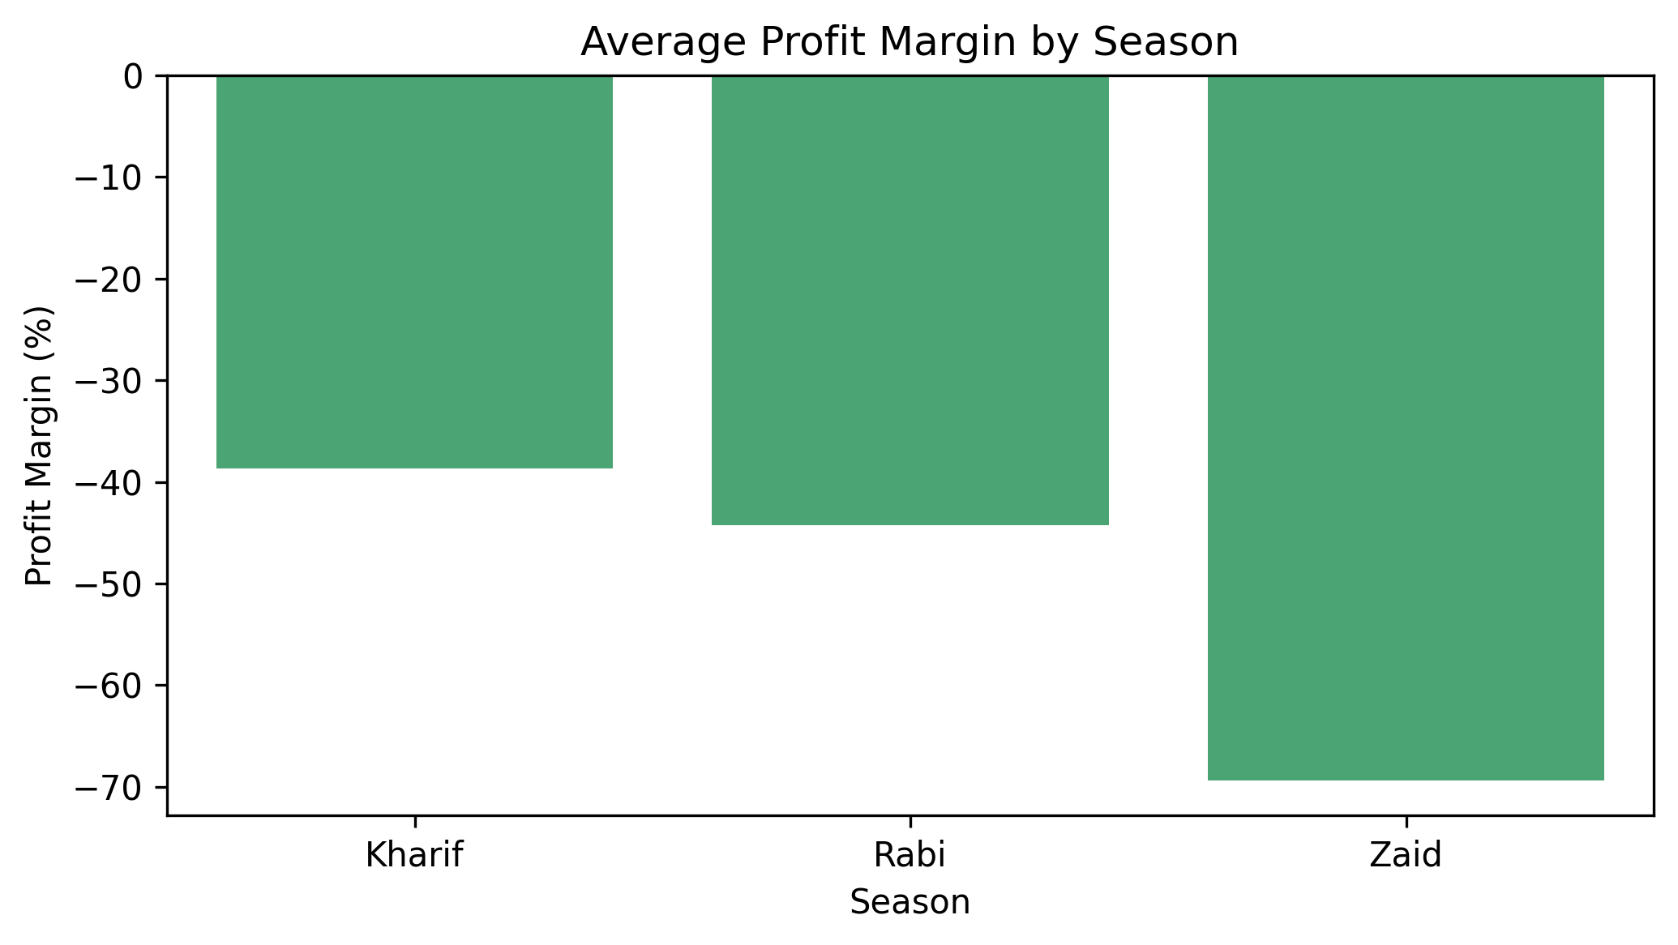
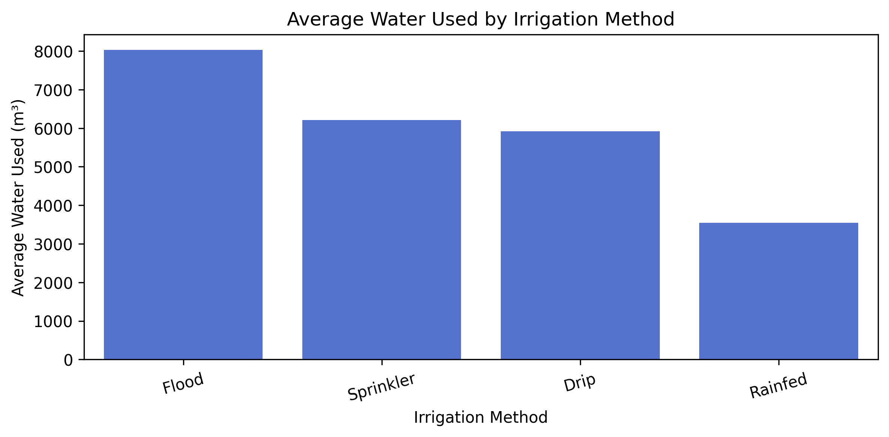
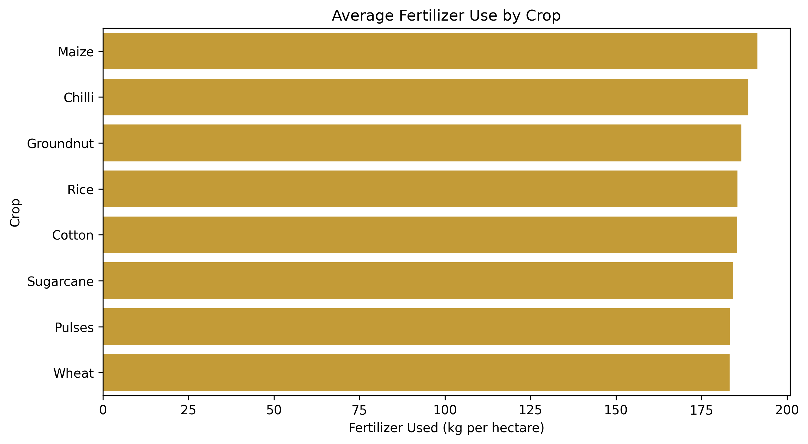
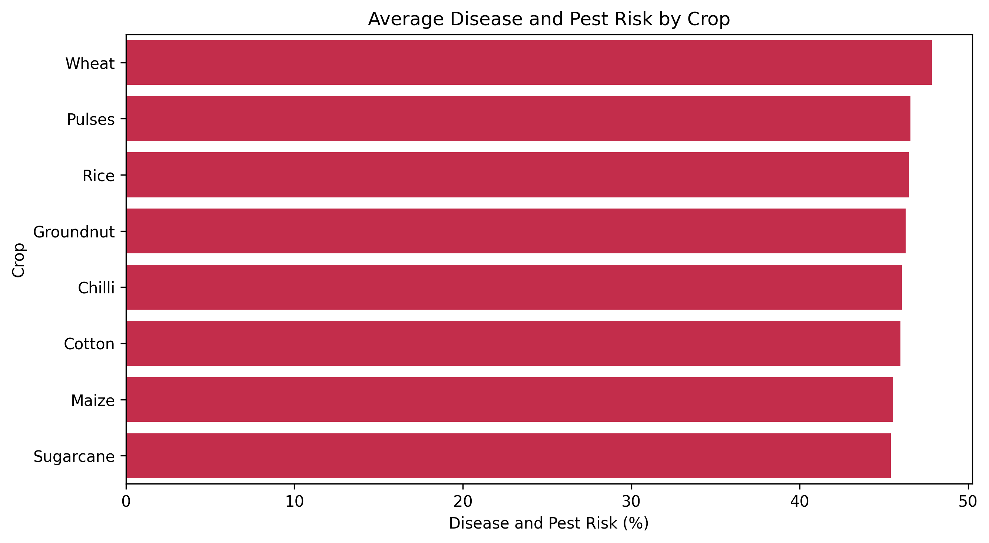
RESULTS

Slide 34
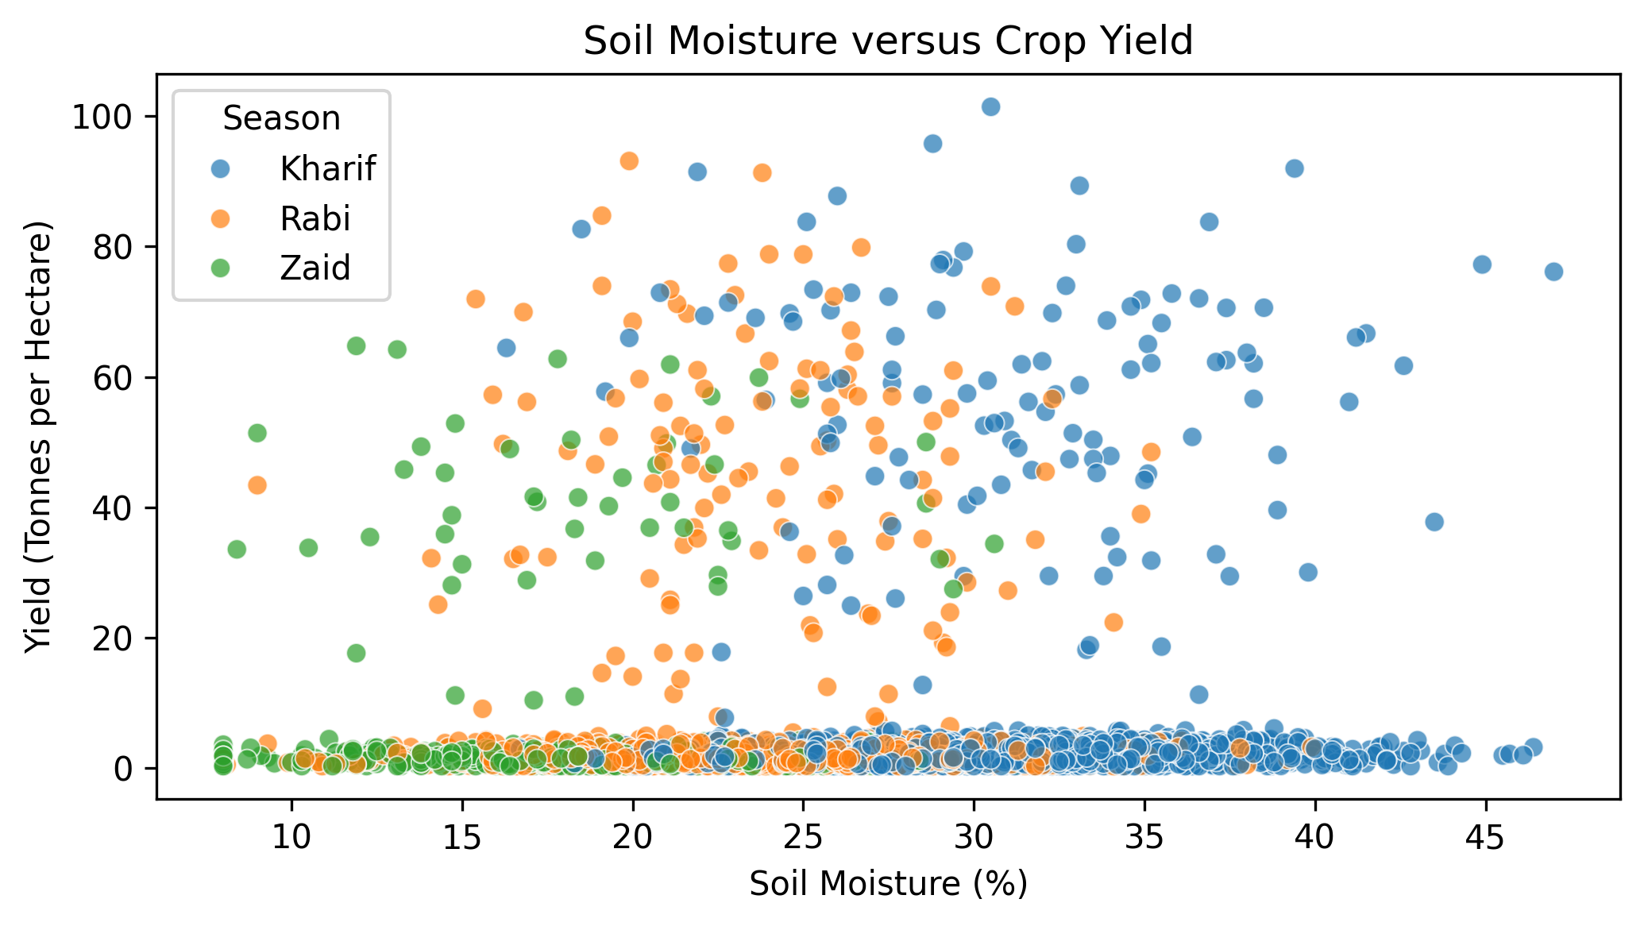
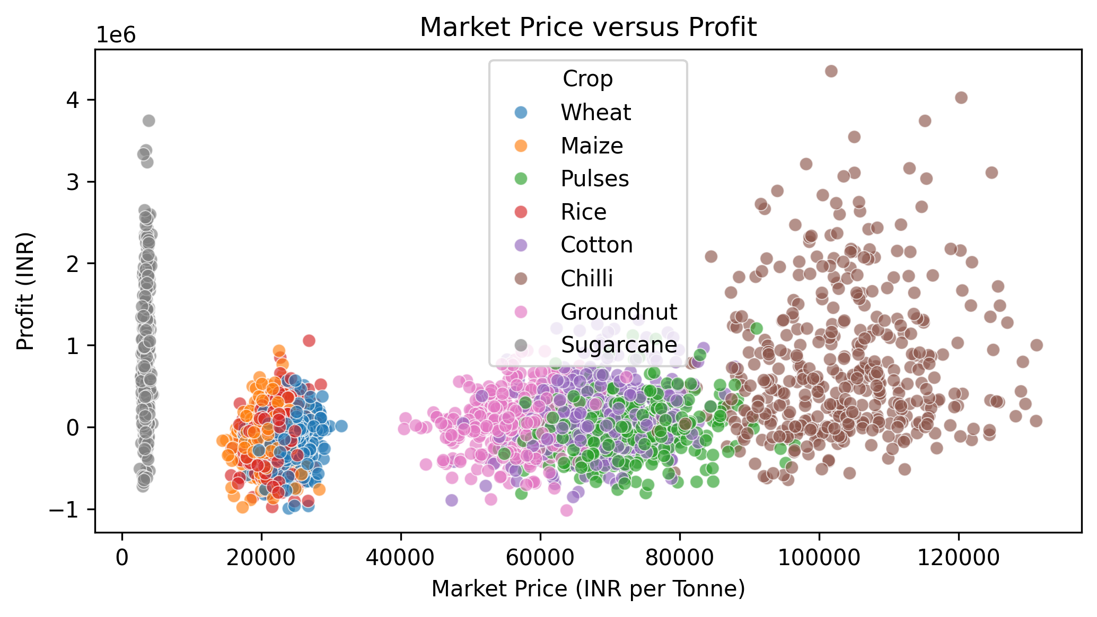
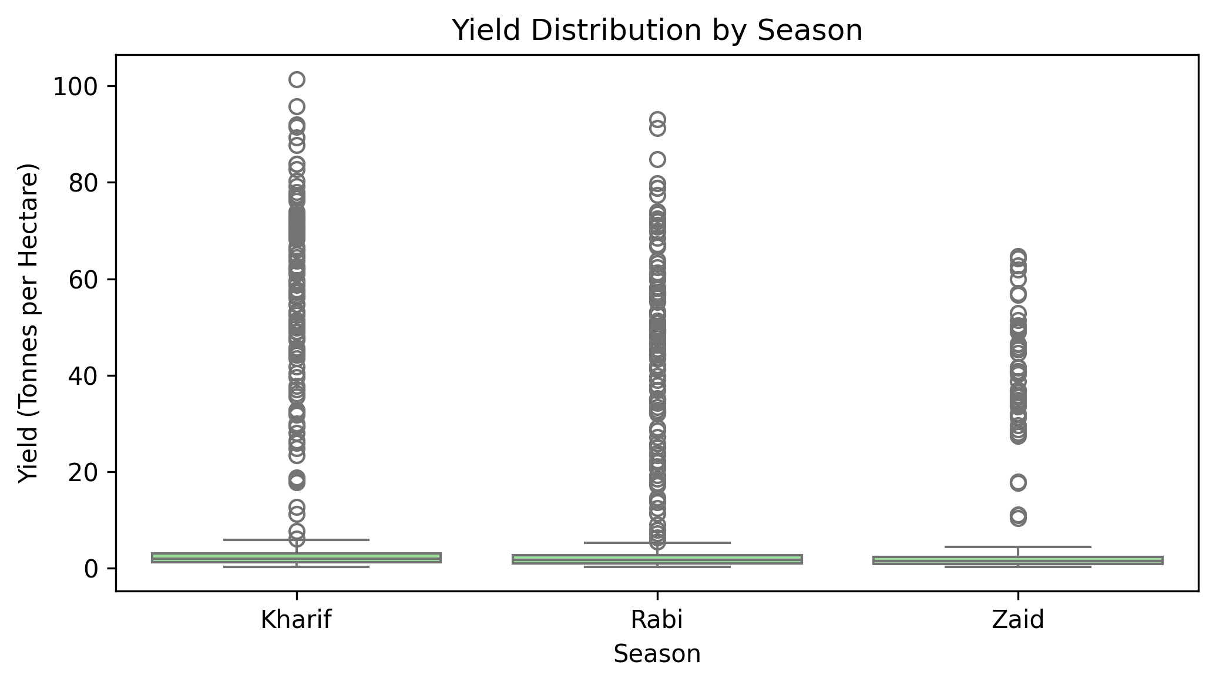
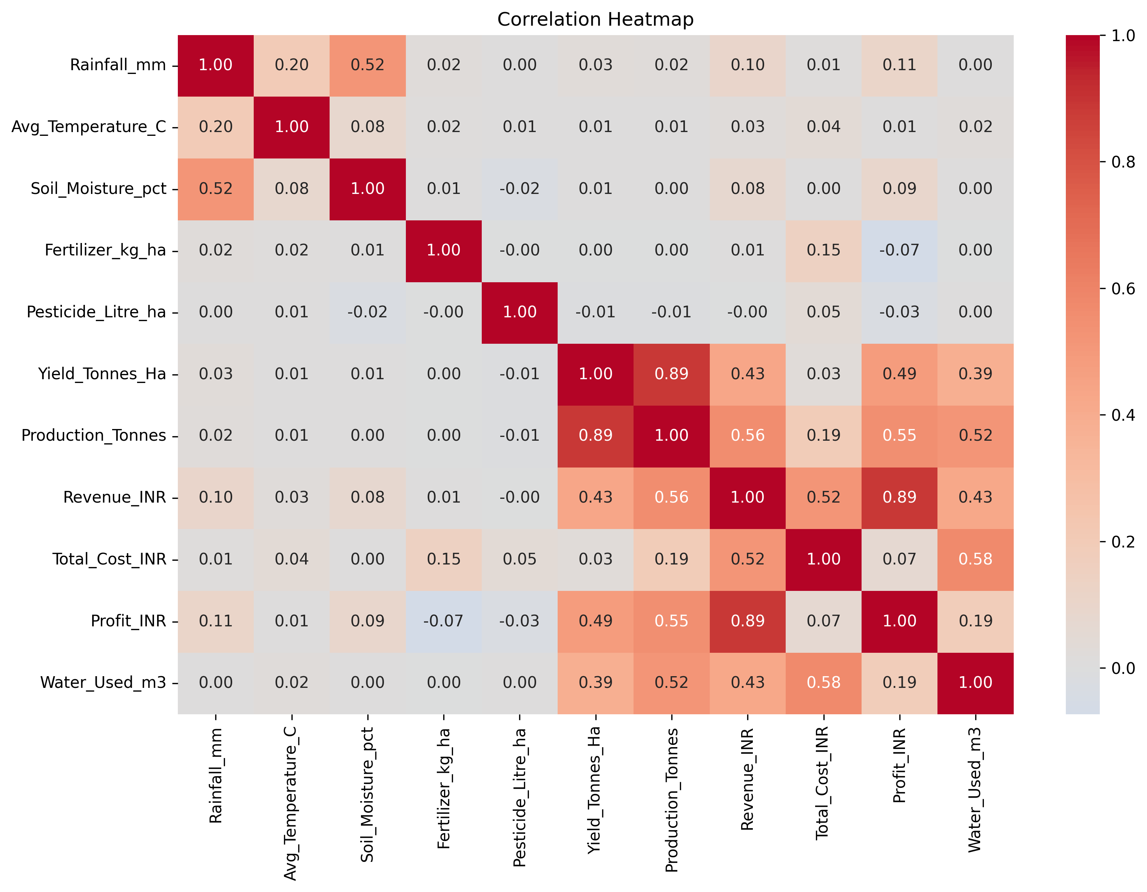
RESULTS

Slide 35
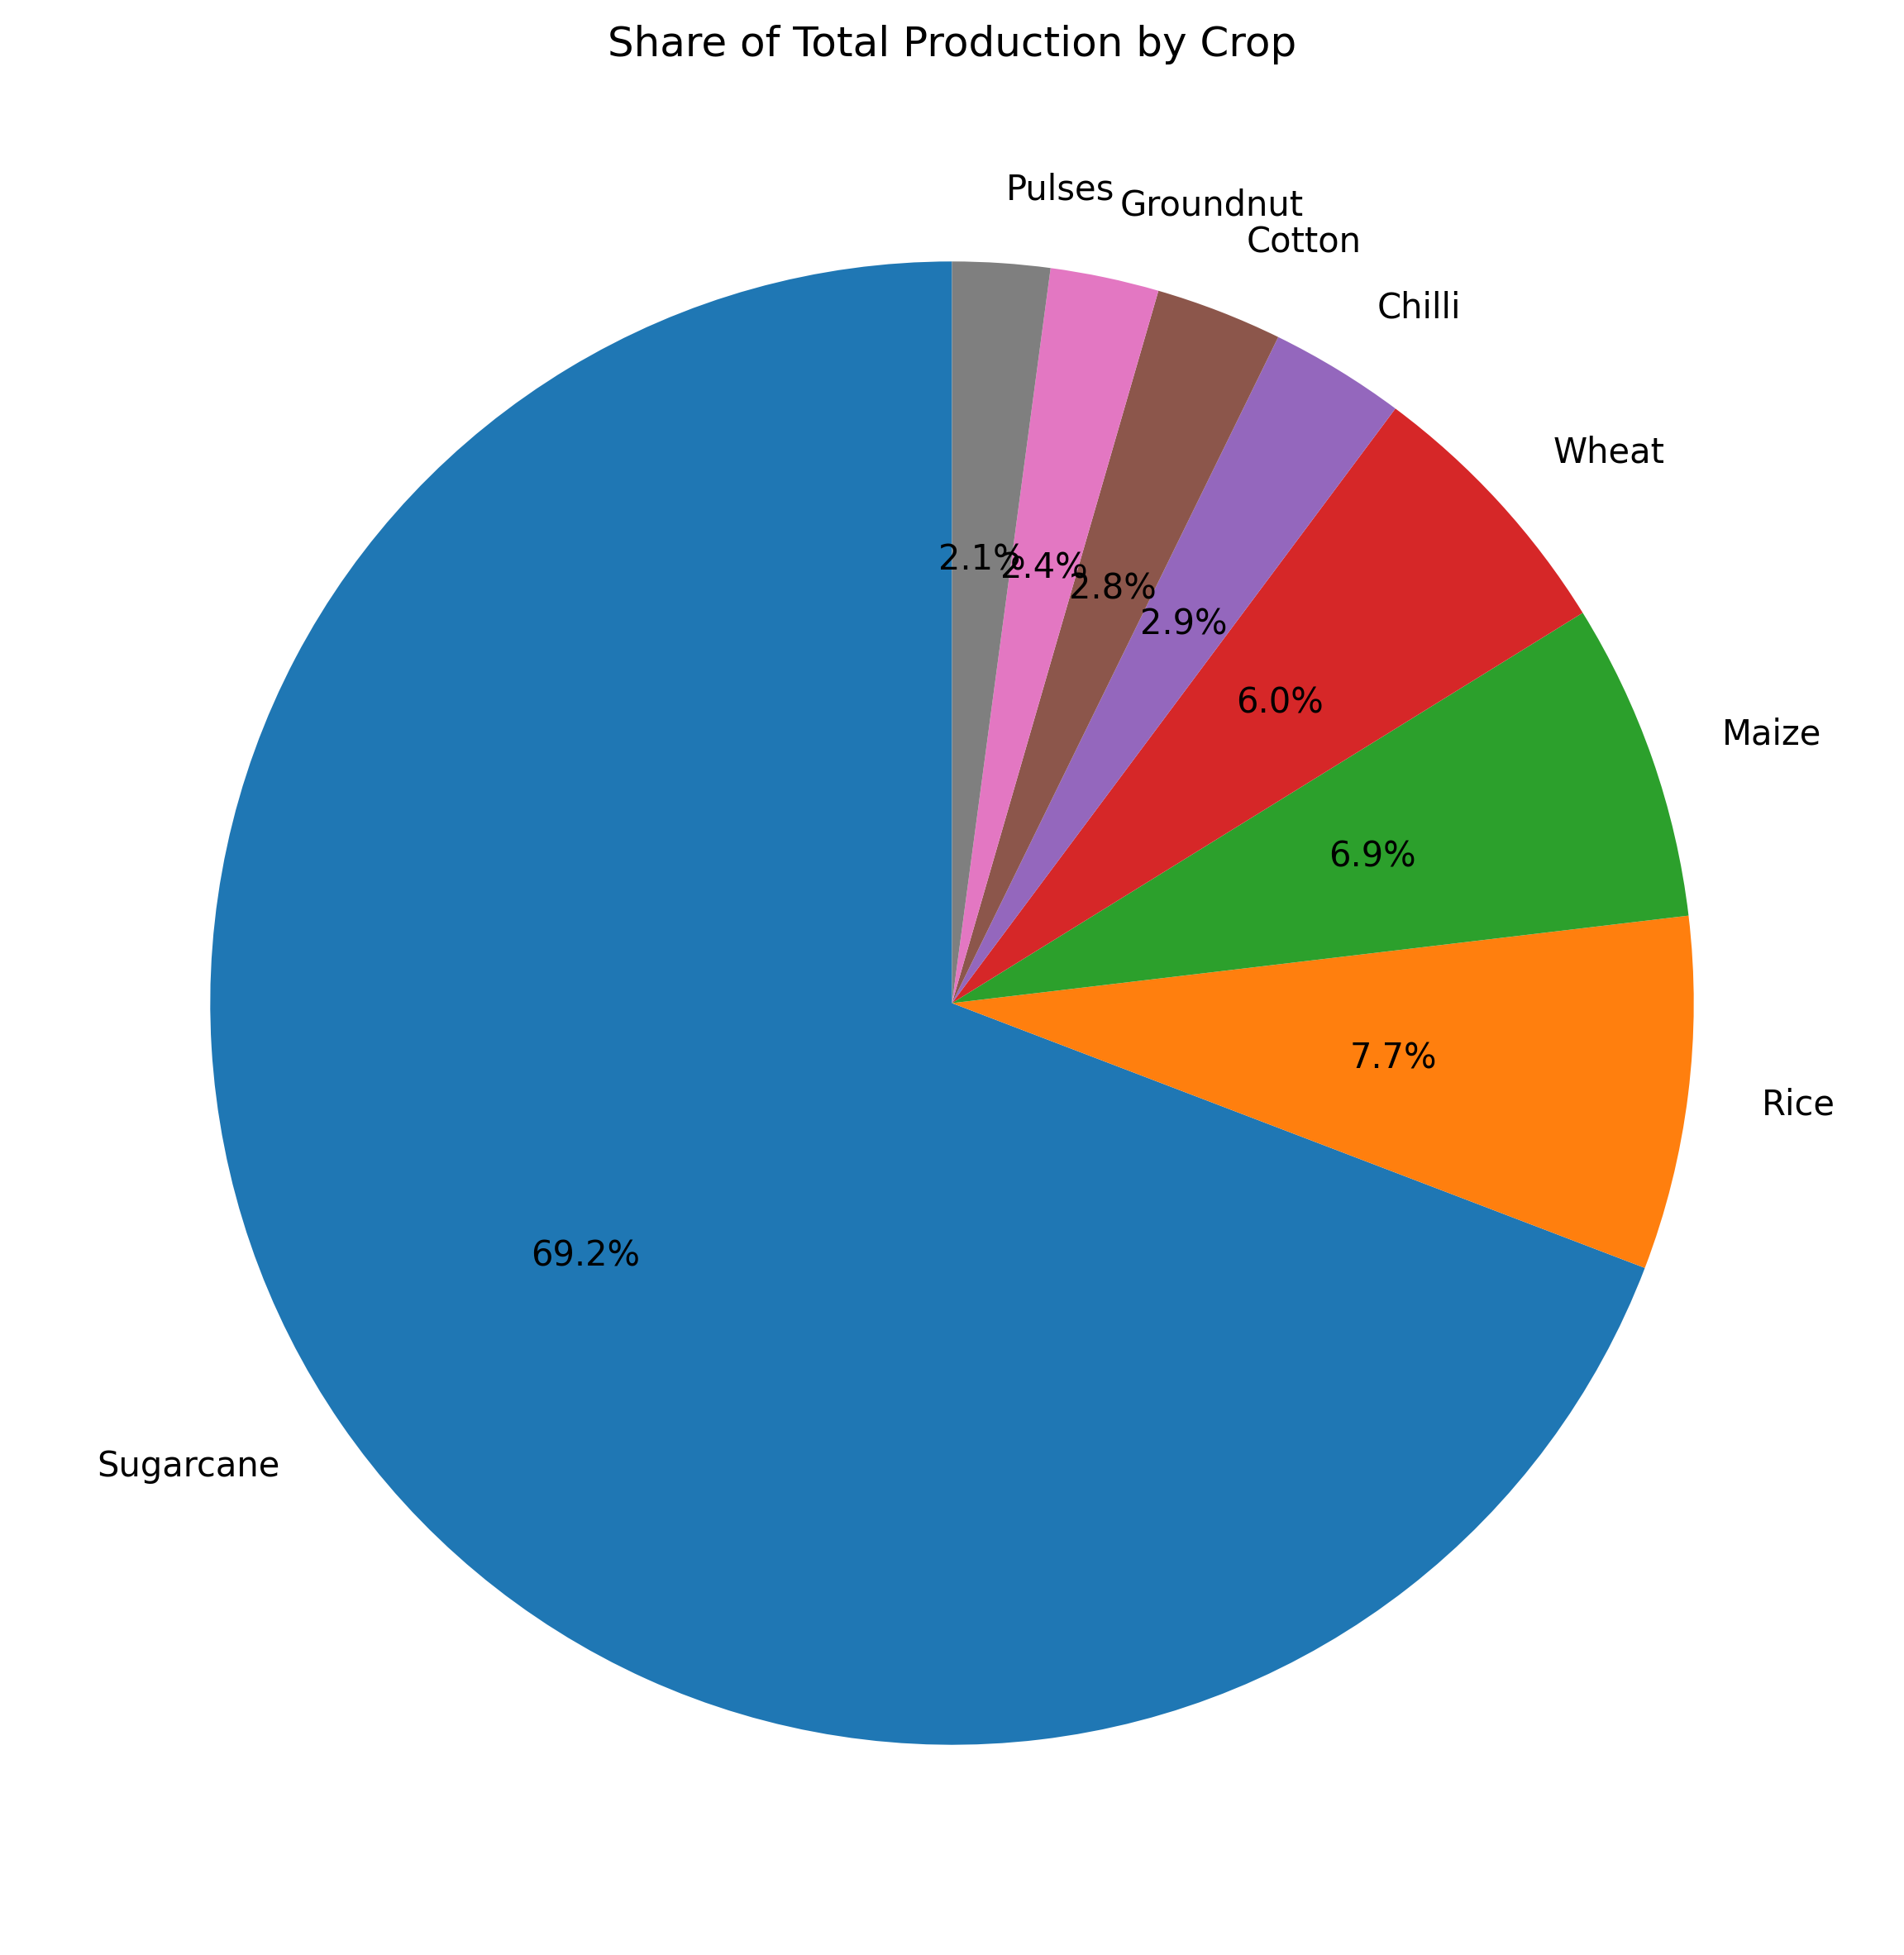
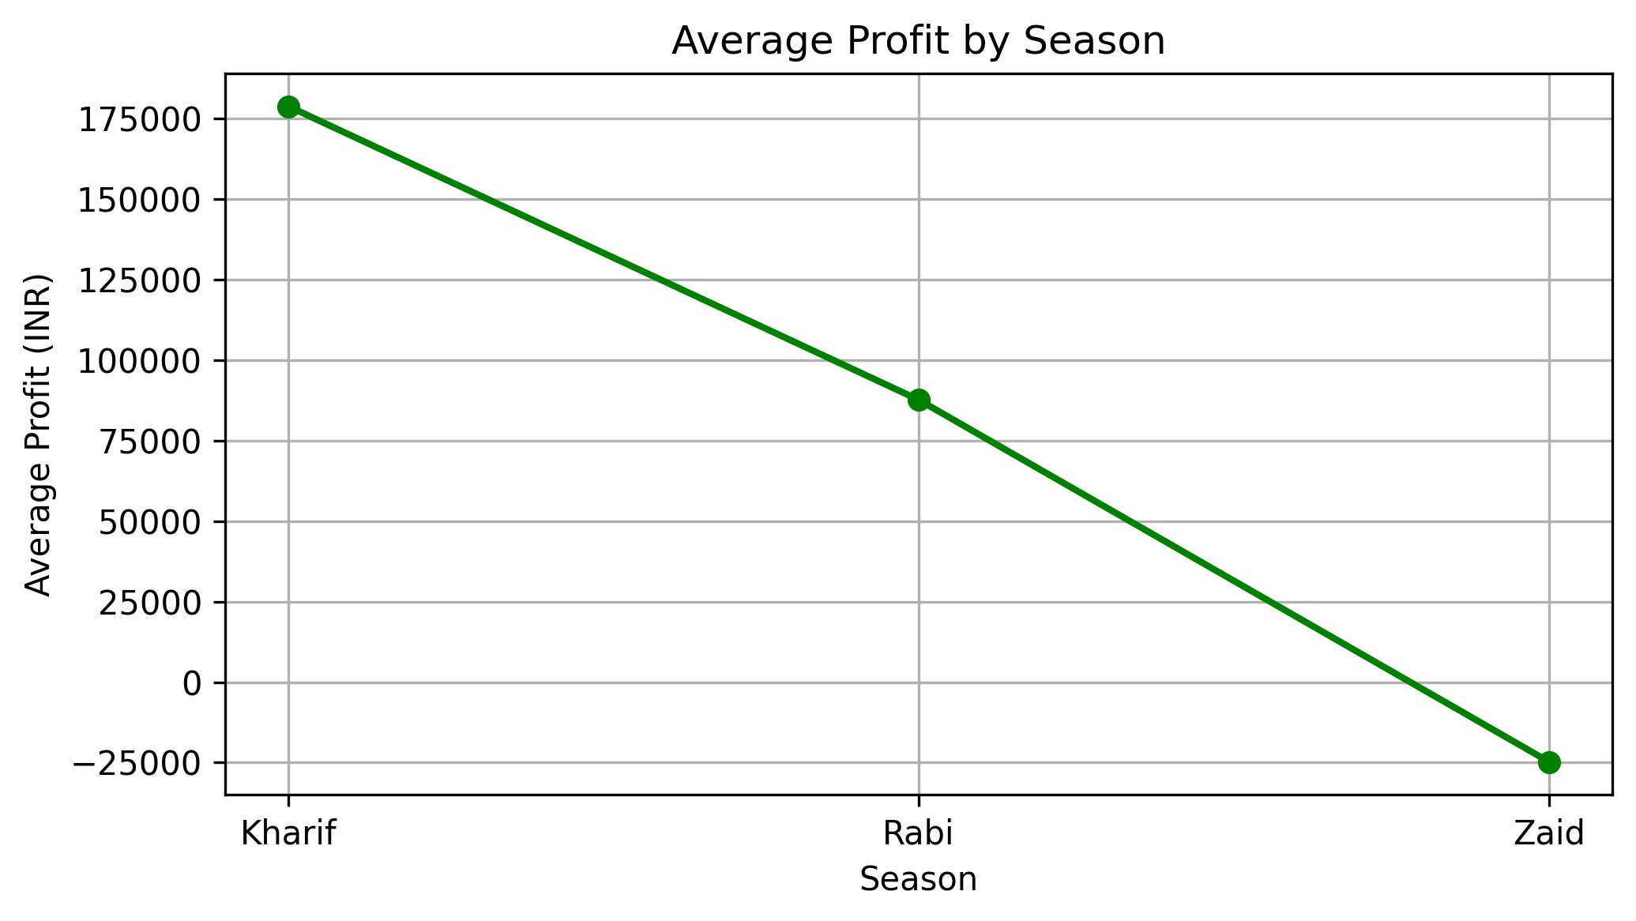
RESULTS

Slide 36
Future scope
The Seasonal Agriculture Performance Analysis project can be extended in several ways:
Predictive Analysis – Machine learning models can be developed to predict crop yield, profit, or agricultural performance for future seasons.
Weather Integration – Real-time weather data such as rainfall, temperature, humidity, and drought conditions can be incorporated to improve seasonal analysis.
Crop Recommendation System – The analysis can be extended into a system that recommends suitable crops based on season, region, soil conditions, and available resources.
Real-Time Agricultural Dashboard – An interactive dashboard using Power BI, Tableau, or Streamlit could allow farmers and agricultural planners to monitor seasonal performance dynamically.
Regional Analysis – More detailed geographical analysis could identify high-performing and low-performing regions and help with region-specific agricultural planning.
Resource Optimization – Future models could recommend optimal usage of water, fertilizer, pesticides, labor, and other resources to improve productivity while reducing costs.
AI-Based Decision Support – AI could be incorporated to provide personalized recommendations to farmers based on historical and current agricultural conditions.
Larger and Real-Time Datasets – Future versions could use larger datasets collected over multiple years to identify long-term trends and make more reliable predictions.

Slide 37

GitHub Link
DEMO LINK

Slide 38
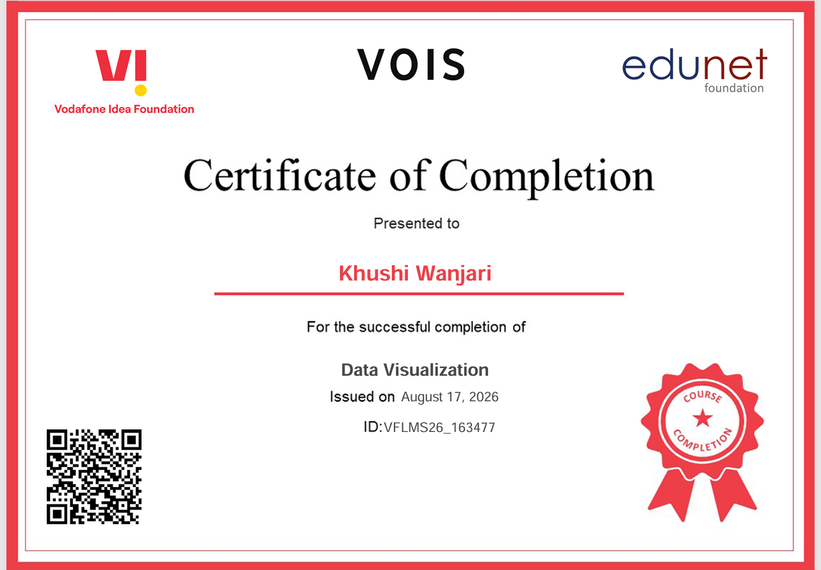
VOIS Course completion certificate - Course name- Data Visualization

Slide 39
Thank you
Thank you for reviewing my project on Seasonal Agriculture Performance Analysis. I hope this analysis clearly demonstrates how data can be used to understand crop performance, resource use, environmental conditions, and farm profitability. I am grateful for the opportunity to complete this project and improve my data-analysis skills.

